Slide 1
Year 5 Religious Education Knowledge Organiser Spring 2 Why is the Torah so important to Jewish people?
Key Vocabulary and Terms
Shema- is a Jewish prayer that contains key Jewish beliefs about God. It is also the first two words of part of the Torah. As a prayer it is said every day.
Torah-The Torah, meaning teaching, instruction or law, is the main Jewish holy book.
Tenakh – this includes the Torah (the first five books of Moses), the Nevi’im (the books of the Prophets, including Joshua, Judges, Isaiah and Jeremiah)) and the Ketuvim (the ‘holy writings’, including Esther, Daniel, Psalms, Job and Ruth).
Jewish-A person/people who follow the beliefs and teachings of Judaism.
Progressive and orthodox
synagogue-The place of worship for Jewish people.
God-Jews believe in one Creator God who cares for all people
What we will learn:
Make sense of belief:
Identify and explain Jewish beliefs about God
Give examples of some texts that say what God is like and explain how Jewish people interpret them
Understand the impact:
Make clear connections between Jewish beliefs about the Torah and how Jews use and treat it
Make clear connections between Jewish commandments and how Jews live (e.g. in relation to kosher laws)
Give evidence and examples to show how Jewish people put their beliefs into practice in different ways (e.g. some differences between Orthodox and Progressive Jewish practice)
Make connections:
• Make connections between Jewish beliefs studied and explain how and why they are important to Jewish people today
• Consider and weigh up the value of e.g. tradition, ritual, community, study and worship in the lives of Jews today, and articulate responses on how far they are valuable to people who
Lent and Easter Week

Slide 2
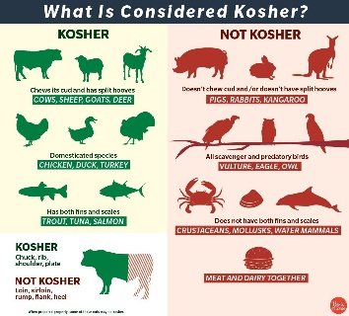
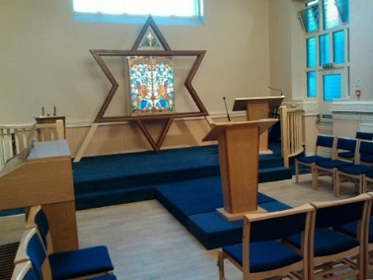
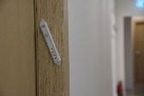
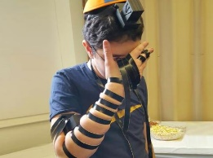
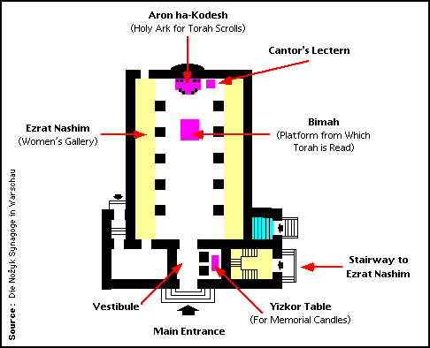
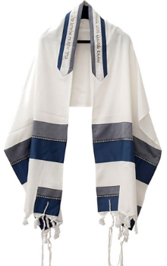
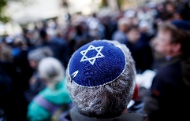
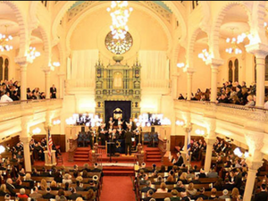
Kosher food
Mezuzah, Tefillin, Tallit, Kippah-
mezuzah-rolled paper (parchment) inside a small box that has the words of The Shema on. Jewish people fix these to their doorposts and touch it as they go in and out of the house.
Tefillin-a set of small black leather boxes
containing scrolls of parchment,
Tallit-a Jewish prayer shawl.
Kippah-outward sign of Jewish faith. A skull cap worn on the head.
synagogue
The main differences between an Orthodox synagogue and a Reform synagogue is that men and women can sit together in a Reform synagogue, whereas they must sit apart in an Orthodox synagogue. Reform Jews also allow the ordination of women, which is a practice that is not permitted by Orthodox Jews.

