Slide 1
Year 5 Religious Education Knowledge Organiser Summer 1 How do Christians decide how to live, What would Jesus do? Religious Education explores big questions about life, to find out what people believe and what difference this makes to how they live.
Key Vocabulary and Terms
Gospel-Christian belief in the ‘good news’ that Jesus brings. The four Gospels in the New Testament are Matthew, Mark, Luke and John.
Christian-A person who follows and believes in the teachings of Jesus, God and the Holy Spirit.
Bible-a religious holy book that is special to Christians, Jews and Samaritans.
New Testament-The second half od the Bible that talks about the teachings and person of Jesus.
Jesus-the central figure of Christianity. Christians believe that he was God come to earth in flesh. Jesus says that his words give foundations for living.
Parable a story in the Bible with a hidden meaning.
What we will learn:
Make sense of belief:
Identify features of Gospel texts (for example, teachings, parable, narrative)
Taking account of the context, suggest meanings of Gospel texts studied, and compare their own ideas with ways in which Christians interpret biblical texts
Understand the impact:
Make clear connections between Gospel texts, Jesus’ ‘good news’, and how Christians live in the Christian community and in their individual lives
Make connections:
Make connections between Christian teachings (e.g. about peace, forgiveness, healing) and the issues, problems and opportunities in the world today, including their own lives
Articulate their own responses to the issues studied, recognising different points of view.
Lent and Easter Week

Slide 2
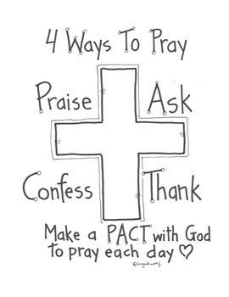
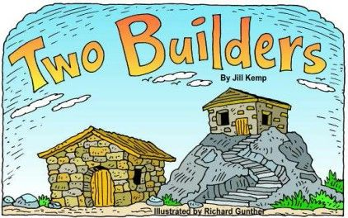
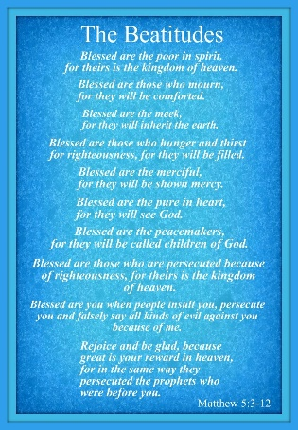
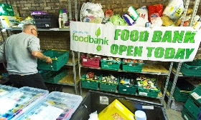
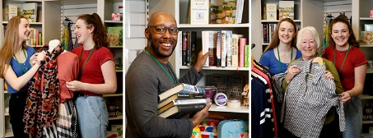
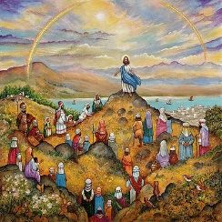
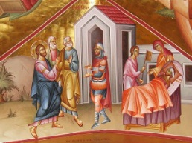
‘The Two Greatest Commandments’
Jesus says that the two greatest Commandments are to love God and love your neighbour. One of our core school values is love. (Matthew 22: 36-40)
Stories in the New Testament that show Christians what Jesus would do.
Types of Prayer
Showing Generosity
Leprosy Mission
Wise and Foolish Builders Matthew 7: 24-27
Sermon on the Mount Matthew 5-7.
Healing Miracle-centurions servant Luke 7: 1-10
Foodbank
Volunteer in a charity shop

