Slide 1
Year 3 Religious Education Knowledge Organiser Summer 2 How and why do people try to make the world a better place? Religious Education explores big questions about life, to find out what people believe and what difference this makes to how they live.
Key Vocabulary and Terms
Jew/Jewish-A person/people who follow the beliefs and teachings of Judaism.
God-Jews and Christians believe in one Creator God who cares for all people and created the world.
Christian-A person who follows and believes in the teachings of Christianity.
Jesus-Christian belief in God coming to earth in human form to save mankind
Bible-a religious holy book that is special to Christians, Jews and Samaritans.
Creator-a person or thing that brings something into existence
Tzedekah- Jewish idea of charitable giving
Tikkun Olam- Jewish duty to mend the world
Zakah/Zakat-Third pillar of Islam, charity giving
Muslim-A person who follows and believes
in the teachings of Islam.
Humanist-a non religious person who has concern for human welfare.
What we will learn:
Make sense of belief:
Identify some beliefs about why the world is not always a good place (e.g. Christian ideas of sin).
Make links between religious beliefs and teachings and why people try to live and make the world a better place
Understand the impact:
Make simple links between teachings about how to live and ways in which people try to make the world a better place (e.g. tikkun olam and the charity Tzedek)
Describe some examples of how people try to live (e.g. individuals and organisations)
Identify some differences in how people put their beliefs into action
Make connections:
Raise questions and suggest answers about why the world is not always a good place, and what are the best ways of making it better
Make links between some commands for living from religious traditions, nonreligious worldviews and pupils’ own ideas
Express their own ideas about the best ways to make the world a better place, making links with religious ideas studied, giving good reasons for their views.
Lent and Easter Week

Slide 2
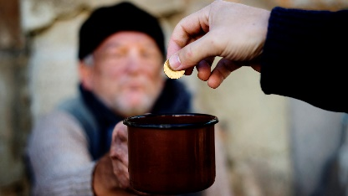
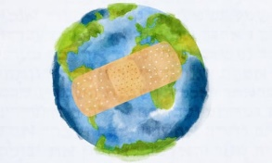
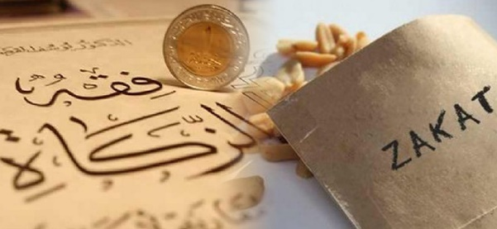
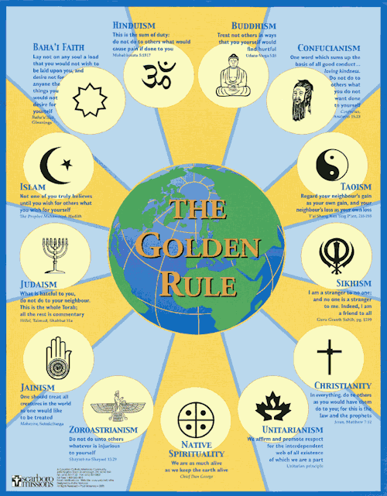
Jewish ideas Muslim Ideas
Tikkun Olam
Tzedakah
Lives of some Christians
The Golden Rule
Mother Theresa
Rosa Parks
Harriet Tubman
Gladys Aylward
Martin Luther King
Corrie Ten Boom
Desmund Tutu
Pope Francis

