Slide 1
Year 5 Religious Education Knowledge Organiser Autumn 1 What does it mean for Christians to believe that God is holy and loving? (God)
Key Vocabulary and Terms
Christian-A person who follows and believes in the teachings of Jesus, God and the Holy Spirit
God-Christian people believe in one God. A divine, holyand loving being who they believe created the world.
humanist-a non religious person who has concern for human welfare and has the right and responsibility to shape their own lives.
Bible-the words/writings in a book that Christians use to guide their lives
Worship-for Christians worship is them expressing their thanks/feelings to God through prayer, songs and words.
What we will learn
Making sense of belief
Identify some different types of biblical texts, using technical terms accurately.
Explain connections between biblical texts and Christian ideas of God, using theological terms.
Making connections
Weigh up how biblical ideas and teachings about God as holy and loving might make a difference in the world today, developing insights of their own
Understanding Impact
Make clear connections between Bible texts studied and what Christians believe about God, for example, through how cathedrals are designed.
Show how Christians put their beliefs into practice in worship

Slide 2
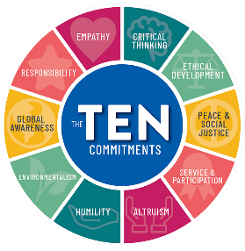
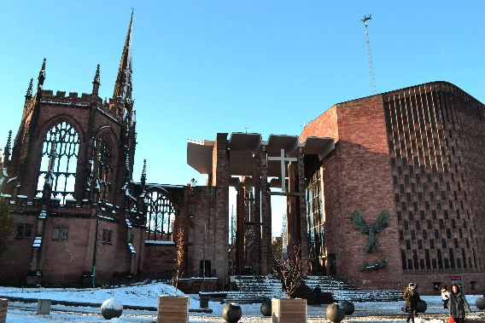
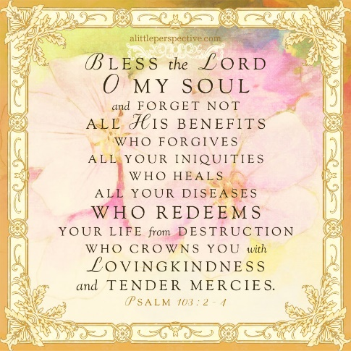
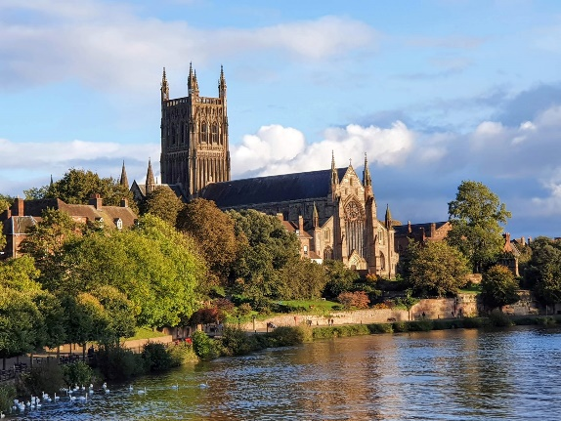
Humanist Guidelines for living and the Ten Commandments
Passages in the Bible about God
Cathedrals:
Medieval Christians built cathedrals ‘to the glory of God.’
Isaiah 6: 1-5
Old and new Coventry cathedral
1 Johns 4: 7-13
Worcester Cathedral
Psalm 103-David

