Slide 1
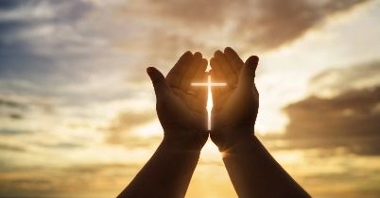
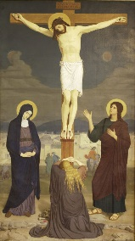
Year 6 Religious Education Knowledge Organiser
Spring 2 What do Christians believe Jesus did to
‘save’ people?(Salvation)
Key Vocabulary and Terms
Christian-A person who follows and believes in the teachings and message of Jesus, God and the Holy Spirit (The Trinity)
Bible-The holy book that Christians read to learn more and guide them in their beliefs.
salvation-Key Christian belief/concept in being rescued by God from the things they have done wrong through Jesus’s death and resurrection.
Jesus/Messiah/Christ-Christians believe that he is the Messiah, God in the flesh, the one who has come to save them.(Incarnation-key Christian concept)
fall-key Christian concept. Evil had now entered the world - this is known as the Fall. In Christian teaching, the sinfulness of Adam and Eve caused a separation from God that could result in humanity's eternal punishment.
Gospels-the record of Christ’s teaching in the first four books of the New Testament part of the Bible
Sacrifice-giving up something that you value for the sake of something else.
Martyr-a person who is killed because of their religious beliefs.
What we will learn
Making sense of belief
Outline the ‘big story’ of the Bible, explaining how Incarnation and Salvation fit within it
Explain what Christians mean when they say that Jesus’ death was a sacrifice
Making connections
Weigh up the value and impact of ideas of sacrifice in their own lives and the world today
Articulate their own responses to the idea of sacrifice, recognising different points of view
Understanding Impact
Make clear connections between the Christian belief in Jesus’ death as a sacrifice and how Christians celebrate Holy Communion/Lord’s Supper
Show how Christians put their beliefs into practice in different ways
Lent and Easter Week

Slide 2
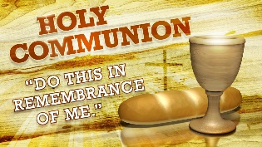
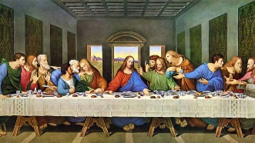
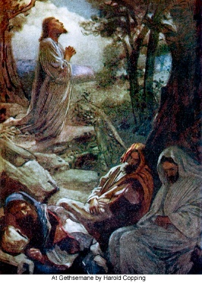
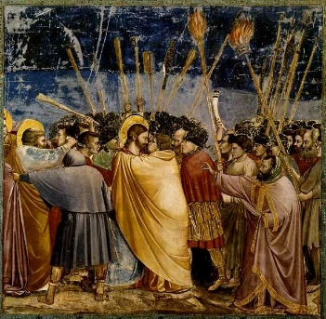
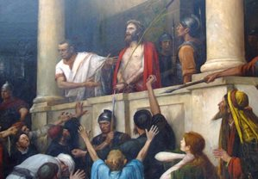
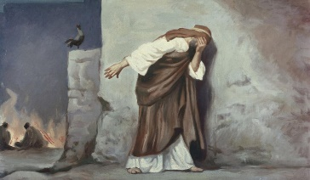
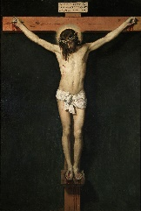
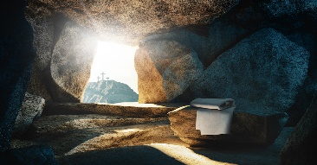
Holy Communion/Mass/Eucharist/Lord’s Supper
Communion or the Lord's Supper is the breaking and eating of bread to symbolize Christ's body broken for
Christian’s and drinking wine to remember the blood he shed for their sins. It says in the Bible that Jesus broke bread and drank wine saying ‘do this in remembrance of me.’
The Last Supper Jesus shared a last meal with his disciples and during the meal he shared bread and wine with them (see above).
1.Garden of Gethsemane After the Last Supper Jesus took some of his disciples outside and told them to keep watch and pray while he went alone to pray to God.
2. Judas’ betrayal and Jesus’ arrest. While in the Garden of Gethsemane, Judas (one of the disciples) came up to Jesus and kissed him, a sign to the soldiers that the man he kissed was Jesus. According to Matthew’s Gospel Judas had betrayed Jesus for a bribe/money.
3. Jesus’ trial The Jewish leaders then take Jesus to Pontius Pilate, the governor of Roman Judaea, and ask that he be tried for claiming to be the King of the Jews.
4. Peter’s denial Jesus had predicted that there would come a time when Peter, one of his disciples, would say that he didn’t know Jesus. Jesus said that on the third time of him saying it, he would hear a cockerel crow.
5. Jesus’ death/crucifixion Jesus had been sentenced to death on a cross at his trial.
6. resurrection-Christian belief in Jesus being ‘raised from the dead’, the third day after he died on the cross.
      1 2 3
      4 5 6

