Slide 1
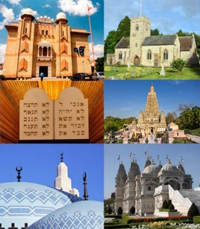
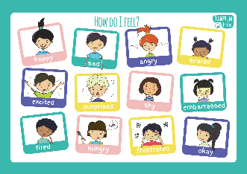
Reception Religious Education Knowledge Organiser
Summer 1 What places are special and why
Religious Education explores big questions about life, to find out what people believe and what difference this makes to how they live.
Key Vocabulary and Terms
Christian-A person who follows and believes in the teachings of Jesus, God and the Holy Spirit.
church The place of worship for a Christian.
special place a place that an individual person likes
holy place a religious place that people see as sacred
memory something that you keep in your mind because it means something to you
Muslim a follower of the religion of Islam
Mosque a Muslim place of worship
feelings
What we will learn
Making sense of belief
Begin to recognise that for Christians, Muslims or Jews, these special things link to beliefs about God
Making connections
Talk about somewhere that is special to themselves, saying why
Get to know and use appropriate words to talk about their thoughts and feelings when visiting a church (or other place of worship)
Express a personal response to the natural world.
Understanding Impact
Recognise that some religious people have places which have special meaning for them
Talk about the things that are special and valued in a place of worship
Lent and Easter Week

Slide 2
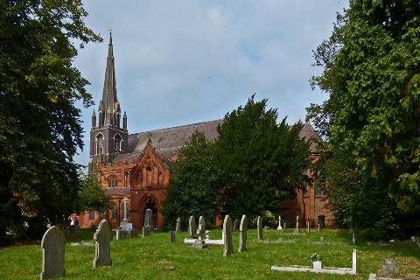
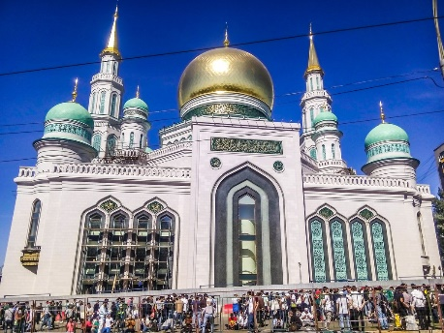
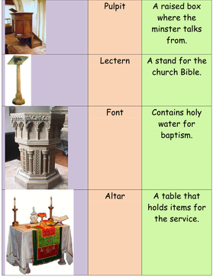
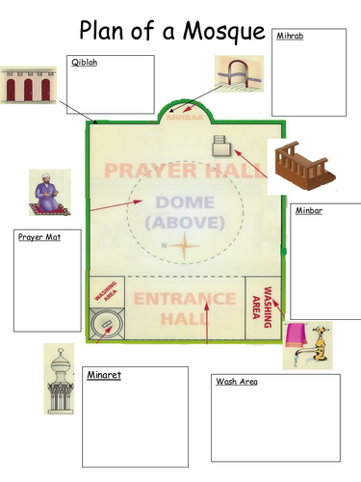
A church and a mosque
church
mosque

