Slide 1
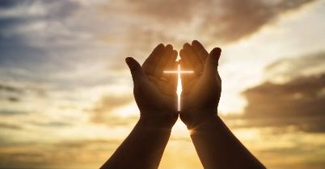
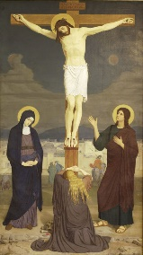
Year 4 Religious Education Knowledge Organiser
Spring 2 Why do Christians call the day Jesus died ‘Good Friday’? (Salvation)
Key Vocabulary and Terms
Christian-A person who follows and believes in the teachings of Jesus, God and the Holy Spirit
Bible-The holy book that Christians read to learn more and guide them in their beliefs.
salvation-Christian belief in being rescued by God from the things they have done wrong through Jesus’s death and resurrection.
Easter-A Christian holiday that celebrates the belief in the resurrection of Christ
Jesus/Messiah/Christ-Christians believe that he is the Messiah, God in the flesh, the one who has come to save them.
resurrection-Christian belief in Jesus being ‘raised from the dead’, the third day after he died on the cross.
Mary-the earthly mother of Jesus.
Gospels-the record of Christ’s teaching in the first four books of the New Testament part of the Bible
What we will learn
Making sense of belief
Recognise the word ‘Salvation’, and that Christians believe Jesus came to ‘save’ or ‘rescue’ people, e.g. by showing them how to live
Offer informed suggestions about what the events of Holy Week mean to Christians
Give examples of what Christians say about the importance of the events of Holy Week
Making connections
Raise thoughtful questions and suggest some answers about why Christians call the day Jesus died ‘Good Friday’, giving good reasons for their suggestions.
Understanding Impact
Make simple links between the Gospel accounts and how Christians mark the Easter events in their communities Describe how Christians show their beliefs about Jesus in worship in different ways
Lent and Easter Week

Slide 2
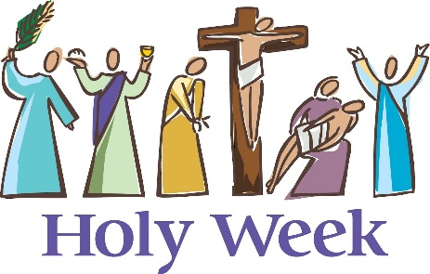
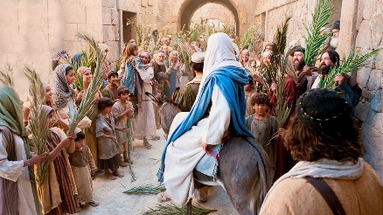
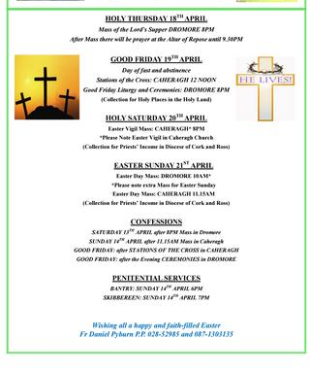
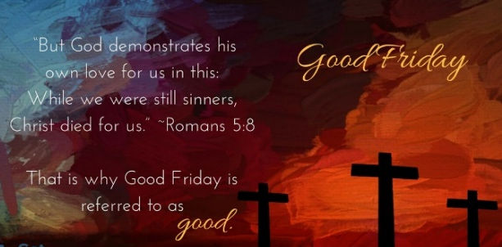
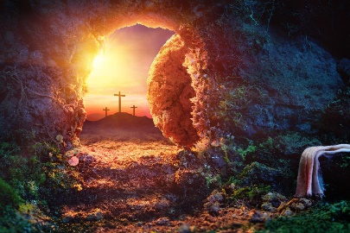
Holy Week
Palm Sunday The first day of Holy week and in the Bible the day that Jesus was welcomed into Jerusalem while riding on a donkey and the crowds waved palm branches at him. In churches around the world this is re-enacted each year.
Good Friday A Christian holiday that remembers the day that Jesus died on a cross. In churches around the world Christians may spend time in prayer and reflection to think about why this day happened.
Easter Sunday A Christian festival and holiday commemorating the resurrection of Jesus from the dead.

