Slide 1
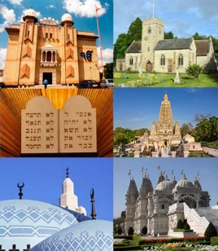
Year 2 Religious Education Knowledge Organiser Summer 2 What makes some places sacred to believers? Religious Education explores big questions about life, to find out what people believe and what difference this makes to how they live.
Key Vocabulary and Terms
Christian-A follower of the religion of Christianity
church a place of worship for Christians
special place a place that an individual person likes
holy something very precious for religious people
sacred something ‘set apart’ from normal everyday items/places
Muslim a follower of the religion of Islam
mosque a place of worship for Muslims
Jew a follower of the religion of Judaism
synagogue a place of worship for Jewish people
What we will learn
Making sense of belief
Recognise that there are special places where people go to worship, and talk about what people do there
Identify at least three objects used in worship in two religions and give a simple account of how they are used and something about what they mean
Identify a belief about worship and a belief about God, connecting these beliefs simply to a place of worship
Making connections
Think, talk and ask good questions about what happens in a church, synagogue or mosque, saying what they think about these questions, giving good reasons for their ideas
Talk about what makes some places special to people, and what the difference is between religious and non-religious special places.
Understanding Impact
Give examples of stories, objects, symbols and actions used in churches, mosques and/or synagogues that show what people believe
Give simple examples of how people worship at a church, mosque or synagogue
Talk about why some people like to belong to a sacred building or a community.
Lent and Easter Week

Slide 2
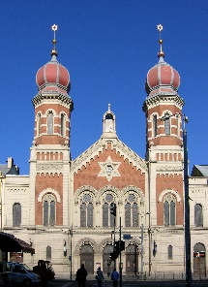
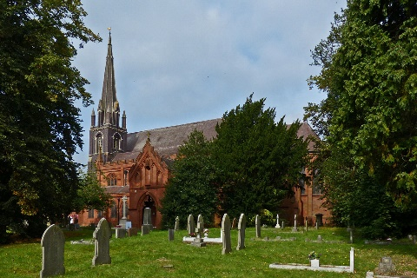
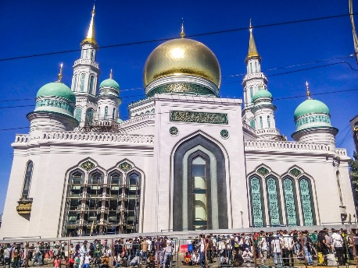
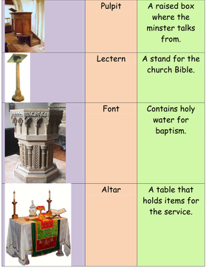
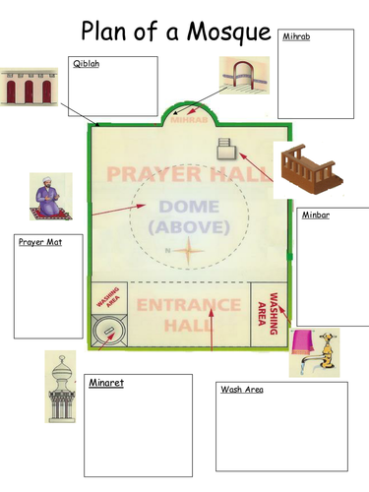
synagogue
church
mosque

