Slide 1
Year 2 Religious Education Knowledge Organiser Summer 1 What is the ‘good news’ Christians say that Jesus brings? Religious Education explores big questions about life, to find out what people believe and what difference this makes to how they live.
Key Vocabulary and Terms
Gospel-Christians believe in the ‘good news’ that Jesus brings.
God-Jews and Christians believe in one Creator God who cares for all people and created the world.
Christian-A person who follows and believes in the teachings of Jesus, God and the Holy Spirit.
Bible-a religious holy book that is special to Christians, Jews and Samaritans.
disciples-Jesus chose 12 men from different backgrounds to be his followers to give him support and help him to spread the ‘good news.’
What we will learn:
Make sense of belief:
Tell stories from the Bible and recognise a link with the concept of ‘Gospel’ or ‘good news’
Give clear, simple accounts of what Bible texts (such as the story of Matthew the tax collector) mean to Christians
Recognise that Jesus gives instructions to people about how to behave
Understand the impact:
Give at least two examples of ways in which Christians follow the teachings studied about forgiveness and peace, and bringing good news to the friendless
Give at least two examples of how Christians put these beliefs into practice in the Church community and their own lives (for example: charity, confession)
Make connections:
• Think, talk and ask questions about whether Jesus’ ‘good news’ is only good news for Christians, or if there are things for anyone to learn about how to live, giving a good reason for their ideas
Lent and Easter Week

Slide 2
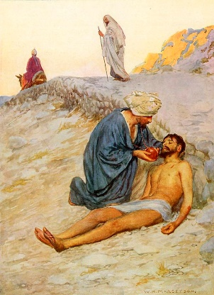
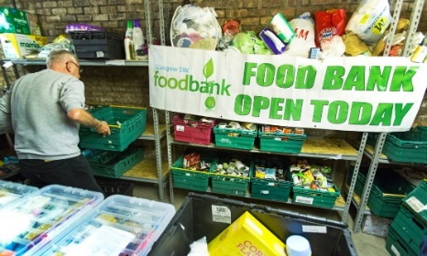
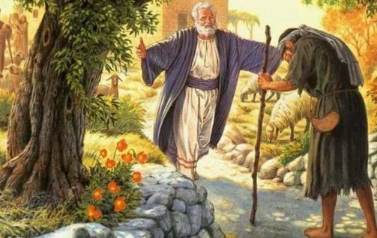
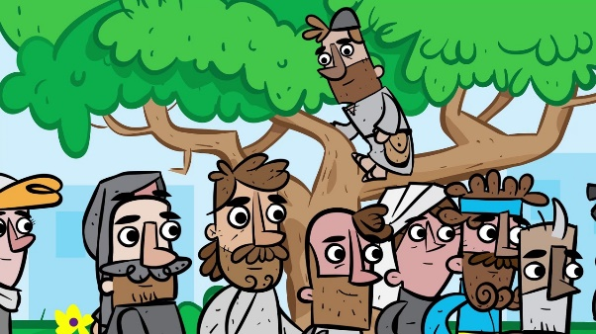
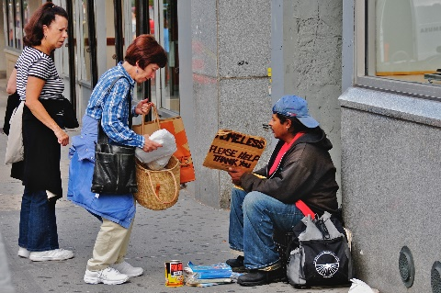
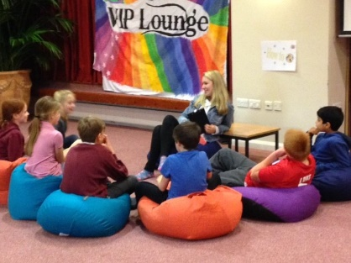
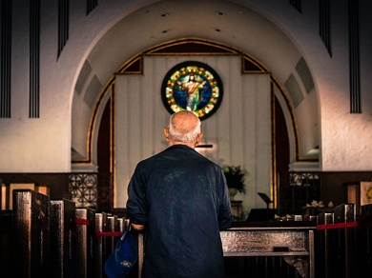
Finding Peace
Music, laughter, quiet, exercise, saying sorry, being forgiven.
Friend to the Homeless and Helpless, friendless
Forgiveness in the Bible and in our school
The Church as a Place for Prayer and Friendship
The Prodigal Son-one of the key Bible stories for the school value of forgiveness.
Foodbanks
The Good Samaritan
Zacchaeus
Helping the homeless

