Slide 1
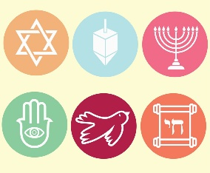
Year 1 Religious Education Knowledge Organiser
Spring 1 and 2 Who is Jewish and what do they believe?
Key Vocabulary and Terms
Shema- is a Jewish prayer and fundamental expression of their belief. It is also the first two words of part of the Torah. As a prayer it is said every day.
Torah-The Torah, meaning teaching, instruction or law, is the main Jewish holy book
Jewish-A person/people who follow the beliefs and teachings of Judaism.
Shabbat-The Jewish day of rest.
Synagogue-The place of worship for Jewish people.
God-Jews believe in one Creator God who cares for all people
What we will learn:
Make sense of belief:
• Recognise the words of the Shema as a Jewish prayer
• Retell simply some stories used in Jewish celebrations (e.g. Chanukah)
• Give examples of how the stories used in celebrations (e.g. Shabbat, Chanukah) remind Jews about what God is like
Understand the impact:
• Give examples of how Jewish people celebrate special times (e.g. Shabbat, Sukkot, Chanukah)
• Make links between Jewish ideas of God found in the stories and how people live
• Give an example of how some Jewish people might remember God in different ways (e.g. mezuzah, on Shabbat)
Make connections:
• Talk about what they think is good about reflecting, thanking, praising and remembering for Jewish people, giving a good reason for their ideas
• Give a good reason for their ideas about whether reflecting, thanking, praising and remembering have something to say to them too.
Lent and Easter Week

Slide 2
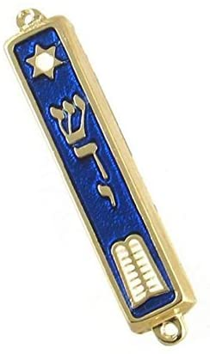
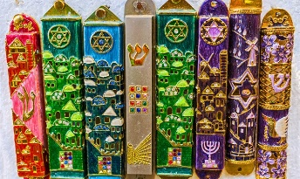
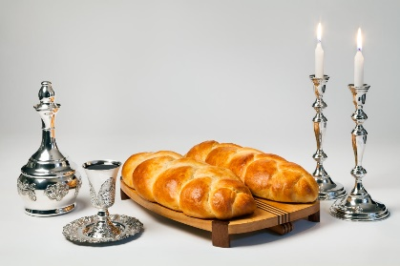
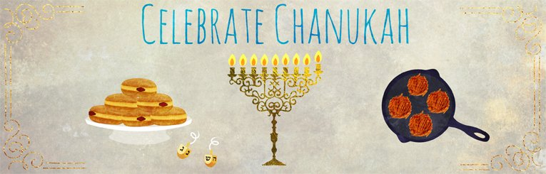
Mezuzah-rolled paper (parchment) inside a small box that has the words of
The Shema on. Jewish people fix these to their doorposts and touch it as they go in and out of the house.
Shabbat
Shabbat, or the Jewish day of rest, starts at sunset on Friday and lasts until three stars appear in the sky on Saturday.
Friday nights are special, involving time at the synagogue, prayers, a meal with family and friends and the chance to rest, discuss and focus on God.
Shabbat celebrates the seventh day of creation – the day of rest – and is called ‘the day of delight’ in some Jewish traditions.
Chanukah
Sometimes also called Hanukkah
Hanukkah is a Jewish holiday which celebrates the victory of the Maccabees over the larger Syrian army. It also celebrates a miracle that happened during this time, where just a day's supply of oil allowed the menorah (Hanukkiah or Hanukkah Menorah-candlestick in the picture below) in the Temple in Jerusalem to remain lit for eight days.

