Slide 1
Year 5 Religious Education Knowledge Organiser
Spring 1 What does it mean to be a Muslim in Britain today?
Religious Education explores big questions about life, to find out what people believe and what difference this makes to how they live.
Key Vocabulary and Terms
Muslim a follower of the religion of Islam-exact meaning of the word is: one who willingly submits to God
God/Allah A divine/holy being/leader that is important in the lives of Muslims
Qu’ran Muslim holy book, a guide to how Muslim's live their lives
Prophet Muhammad (PBUH-peace be upon him) Religious leader/prophet of Allah who received the words of the Qu’ran on Mt.Hira
Islam-the religion of Muslims-exact meaning of the word is: the peace that comes from being in harmony with God
salaam is a greeting that means ‘peace’
ibadah-worship and belief in action
Hadith-collections of the words of Muhammad
Sunnah-actions of Muhammad, showing Muslims hoe to behave
What we will learn
Making sense of belief
Identify and explain Muslim beliefs about God, the Prophet and the Holy Qur’an (e.g. Tawhid; Muhammad as the Messenger, Qur’an as the message)
Describe ways in which Muslim sources of authority guide Muslim living (e.g. Qur’an guidance on Five Pillars; Hajj practices follow example of the Prophet)
Making connections
Make connections between Muslim beliefs studied and Muslim ways of living in Britain/your region today
Consider and weigh up the value of e.g. submission, obedience, generosity, self-control and worship in the lives of Muslims today and articulate responses on how far they are valuable to people who are not Muslims.
Reflect on and articulate what it is like to be a Muslim in Britain today, giving good reasons for their views
Understanding Impact
Make clear connections between Muslim beliefs and ibadah (e.g. Five Pillars, festivals, mosques, art)
Give evidence and examples to show how Muslims put their beliefs into practice in different ways
Lent and Easter Week

Slide 2
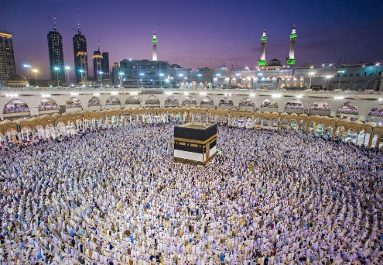
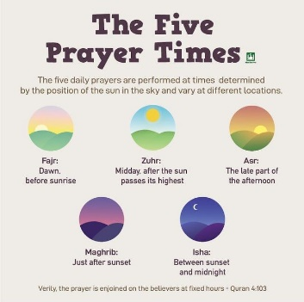
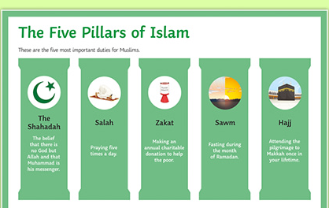
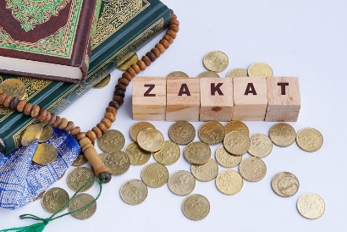
The Five Pillars of Islam-the five key practices that all
Muslims are obligated to fulfil during their lifetime. They form the foundations of Muslim belief and produce a structure for daily spiritual life.
Shahadah (the second pillar) the statement that Muslims say to show what they believe
Salah-(the second Pillar)
Prayer positions and timings
Zakat- (the third pillar)-alms/giving/charity
Sawm-(the fourth pillar) of fasting during Ramadan
Hajj-(the fifth pillar)
Pilgrimage

