Slide 1
Year 6 Religious Education Knowledge Organiser
Summer 1 For Christians what kind of King was Jesus?
Religious Education explores big questions about life, to find out what people believe and what difference this makes to how they live.
Key Vocabulary and Terms
Kingdom of God-sometimes called Kingdom of Heaven, is the Christian belief in a spiritual realm over which God reigns as king
Christian-A person who follows and believes in the teachings of Jesus, God and the Holy Spirit.
Bible-a religious holy book that is special to Christians, Jews and Samaritans.
New Testament-The second half od the Bible that talks about the teachings and person of Jesus.
Jesus-the central figure of Christianity. Christians believe that he was God come to earth in flesh.
Parable-a story that Jesus told in the Bible with a hidden meaning..
What we will learn:
Make sense of belief:
Explain connections between biblical texts and the concept of the kingdom of God
Consider different possible meanings for the biblical texts studied, showing awareness of different interpretations
Understand the impact:
Make clear connections between belief in the kingdom of God and how Christians put their beliefs into practice Show how Christians put their beliefs into practice in different ways
Make connections:
Relate the Christian ‘kingdom of God’ model (i.e. loving others, serving the needy) to issues, problems and opportunities in the world today
Articulate their own responses to the idea of the importance of love and service in the world today
Lent and Easter Week

Slide 2
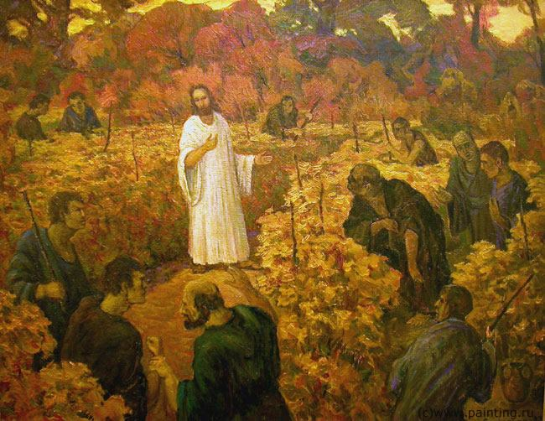
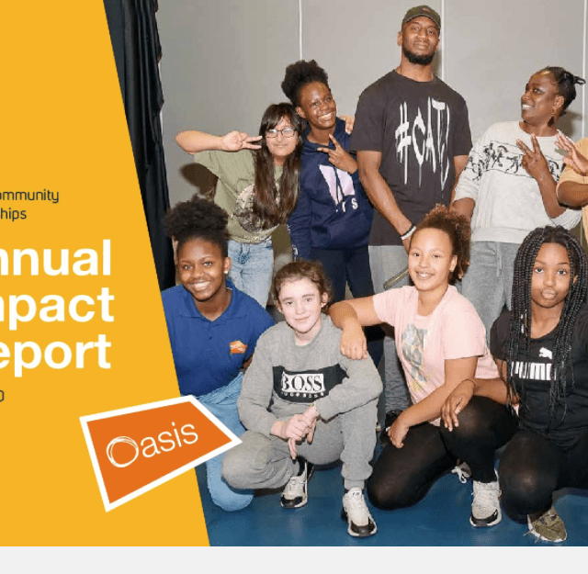
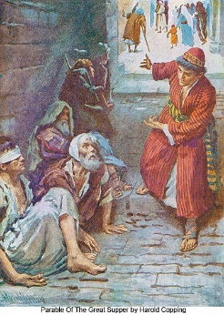
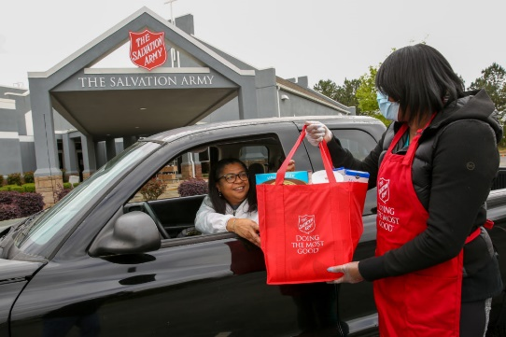
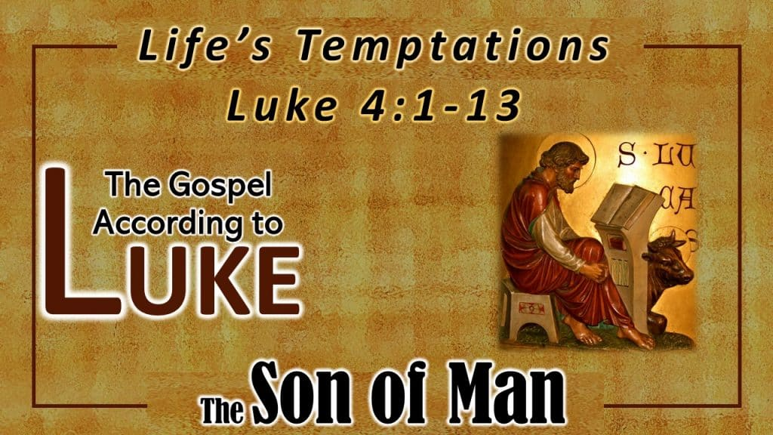
The Two Greatest Commandments
Jesus says that the two greatest Commandments are to love God and love your neighbour. One of our core school values is love. (Matthew 22: 36-40)
Stories in the New Testament that show Jesus’ idea of Kingship
Jesus’ Kingship in action today
Oasis churches
Salvation army
The Feast Luke 14: 12-24
The Tenants in the Vineyard
Matthew 21: 33-46

