Slide 1
Year 4 Religious Education Knowledge Organiser
Summer 1 For Christians what was the impact of Pentecost?
Religious Education explores big questions about life, to find out what people believe and what difference this makes to how they live.
Key Vocabulary and Terms
Kingdom of God-sometimes called Kingdom of Heaven, is the Christian belief in a spiritual realm over which God reigns as king
Christian-A person who follows and believes in the teachings of Jesus, God and the Holy Spirit.
Bible-a religious holy book that is special to Christians, Jews and Samaritans.
New Testament-The second half od the Bible that talks about the teachings and person of Jesus.
Jesus-the central figure of Christianity. Christians believe that he was God come to earth in flesh.
Holy Spirit-for Christians it is the third part of the Trinity-Father, Son and Holy Spirit.
What we will learn:
Make sense of belief:
Make clear links between the story of Pentecost and Christian beliefs about the ‘kingdom of God’ on Earth
Offer informed suggestions about what the events of Pentecost in Acts 2 might mean
Give examples of what Pentecost means to some Christians now
Understand the impact:
Make simple links between the description of Pentecost in Acts 2, the Holy Spirit, the kingdom of God, and how Christians live now
Describe how Christians show their beliefs about the Holy Spirit in worship
Make connections:
• Make links between ideas about the kingdom of God in the Bible and what people believe about following God today ,giving good reasons for their ideas
Lent and Easter Week

Slide 2
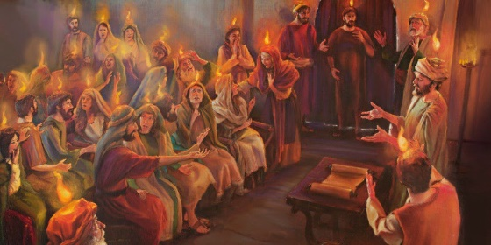
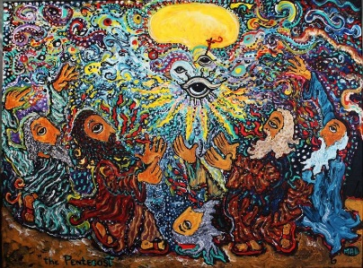
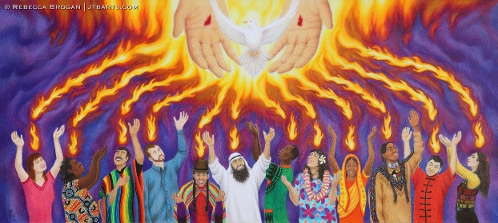
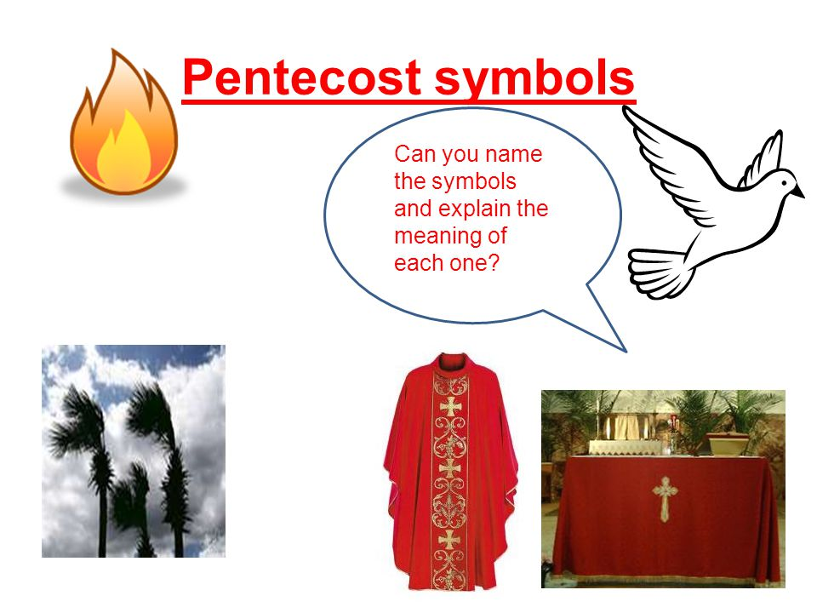
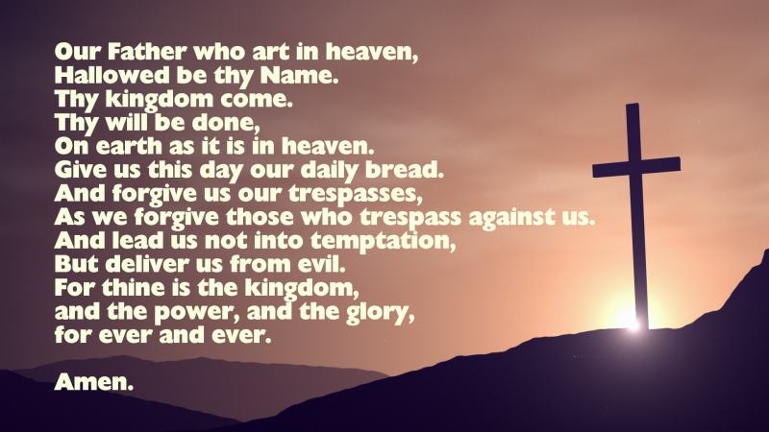
Pentecost
Pentecost happens 50 days after Easter and it is the Christian belief in the Holy Spirit coming to the disciples and followers of Jesus.
Symbols of Pentecost
Artwork for Pentecost
The Lord’s Prayer
Act 2: 1-15, 22, 37-41.
flames
dove
wind
Liturgical colour red

