Slide 1
Year 3 Religious Education Knowledge Organiser Summer 1 What kind of world did Jesus want? Religious Education explores big questions about life, to find out what people believe and what difference this makes to how they live.
Key Vocabulary and Terms
Gospel-Christian belief in the ‘good news’ that Jesus brings. The four Gospels in the New Testament are Matthew, Mark, Luke and John.
Christian-A person who follows and believes in the teachings of Jesus, God and the Holy Spirit.
Bible-a religious holy book that is special to Christians, Jews and Samaritans.
New Testament-The second half od the Bible that talks about the teachings and person of Jesus.
disciples-Jesus chose 12 men from different backgrounds to be his followers to give him support and help him to spread the ‘good news.’
What we will learn:
Make sense of belief:
Identify texts that come from a Gospel, which tells the story of the life and teaching of Jesus
Make clear links between the calling of the first disciples and how Christians today try to follow Jesus and be ‘fishers of people’
Suggest ideas and then find out about what Jesus’ actions towards outcasts mean for a Christian
Understand the impact:
Give examples of how Christians try to show love for all, including how Christian leaders try to follow Jesus’ teaching in different ways
Make connections:
• Make links between the importance of love in the Bible stories studied and life in the world today, giving a good reason for their ideas
Lent and Easter Week

Slide 2
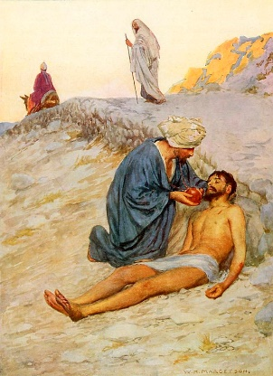
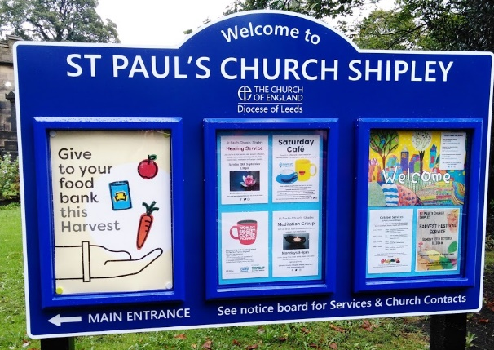
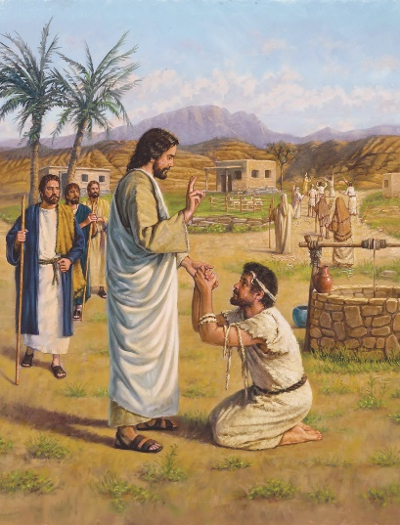
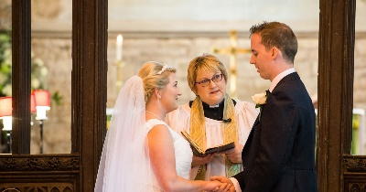
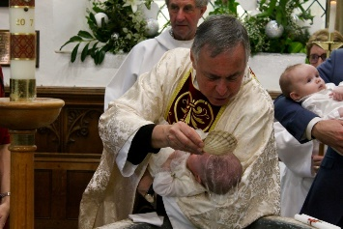
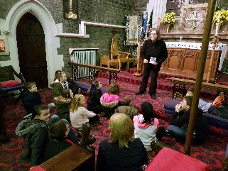
Leprosy Mission
The Teachings of Jesus
Churches Showing the World Jesus wanted
The work of a vicar
The Good Samaritan
Luke 10: 25-37
Our school’s key Bible story for the value of love.
The Healing of the Leper
Mark 1: 40-44

