Slide 1
Year 3 Religious Education Knowledge Organiser
Spring 1 How do festivals and worship show what matters to a Muslim?
Religious Education explores big questions about life, to find out what people believe and what difference this makes to how they live.
Key Vocabulary and Terms
Muslim a follower of the religion of Islam-exact meaning of the word is: one who willingly submits to God
Shahadah the statement that Muslims say to show what they believe
God/Allah A divine/holy being/leader that is important in the lives of Muslims
Qu’ran Muslim holy book, a guide to how Muslim's live their lives
Prophet Muhammad (PBUH-peace be upon him) Religious leader/prophet of Allah who received the words of the Qu’ran on Mt.Hira
Islam-the religion of Muslims-exact meaning of the word is: the peace that comes from being in harmony with God
salaam is a greeting that means ‘peace’
What we will learn
Making sense of belief
Identify some beliefs about God in Islam, expressed in Surah 1.
Make clear links between beliefs about God and ibadah (e.g. how God is worth worshipping; how Muslims submit to God)
Making connections
Raise questions and suggest answers about the value of submission and self-control to Muslims, and whether there are benefits for people who are not Muslims.
Make links between the Muslim idea of living in harmony with the Creator and the need for all people to live in harmony with each other in the world today, giving good reasons for their ideas.
Understanding Impact
Give examples of ibadah (worship) in Islam (e.g. prayer, fasting, celebrating) and describe what they involve.
Make links between Muslim beliefs about God and a range of ways in which Muslims worship (e.g. in prayer and fasting, as a family and as a community, at home and in the mosque)
Lent and Easter Week

Slide 2
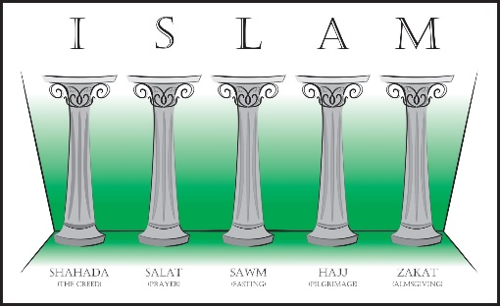
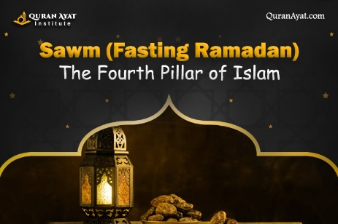
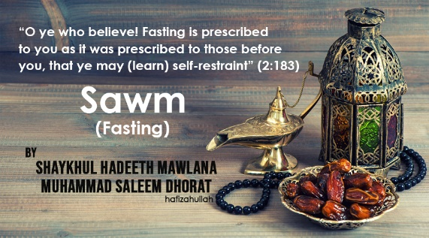
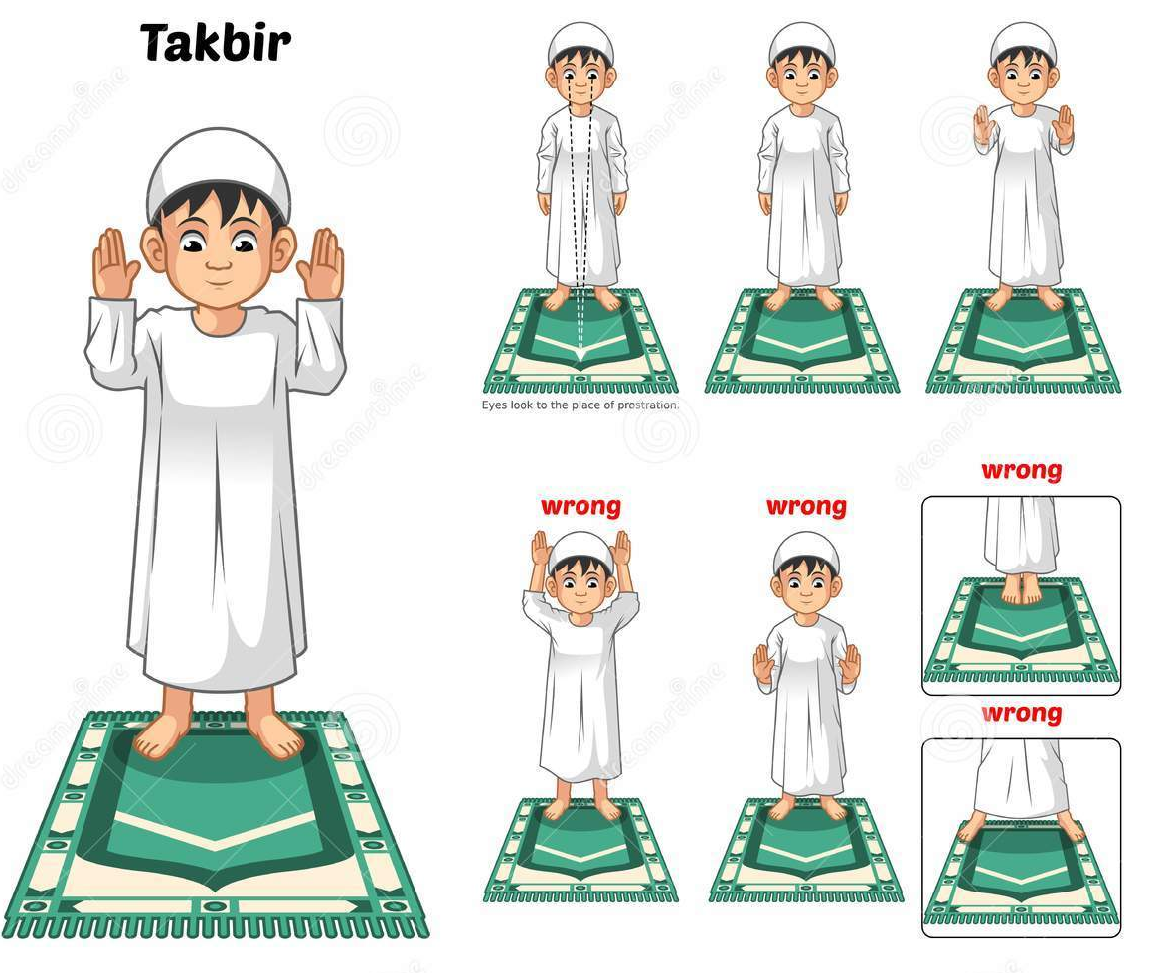
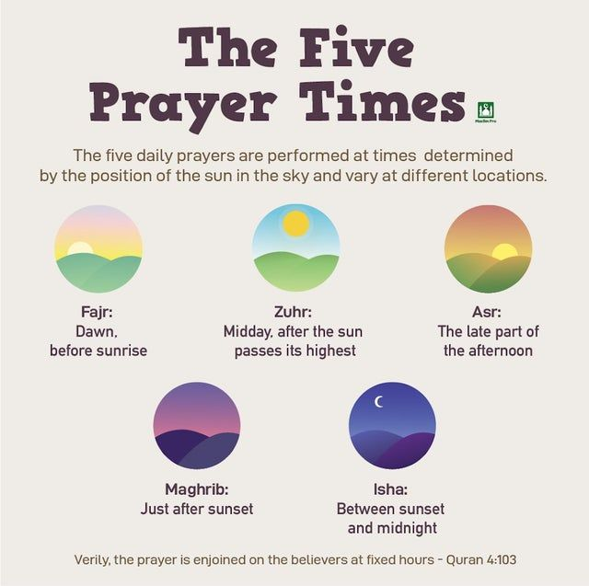
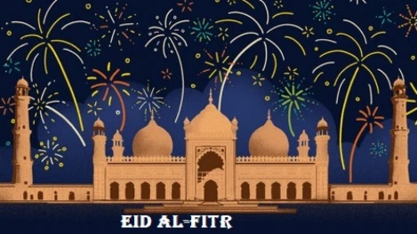
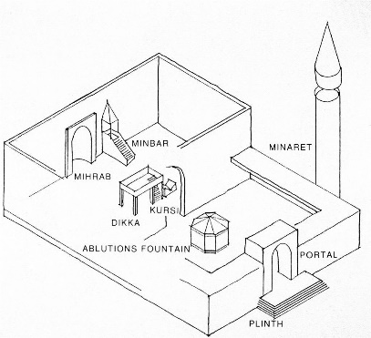
The Five Pillars of Islam-the five key practices that all
Muslims are obligated to fulfil during their lifetime. They form the foundations of Muslim belief.
Sawm-the fourth pillar of fasting during Ramadan
Eid-Ul-Fitr-the celebration
for the end of Ramadan and
Fasting
A mosque-place a worship for
Muslims
Salah-(The second Pillar)
Prayer positions and timings.

