Slide 1
Year 3 Religious Education Knowledge Organiser
Spring 2 How do festivals and family life show what matters to Jewish people?
Key Vocabulary and Terms
Jewish-a person who follows the faith of Judaism and the belief in one God.
Torah-contains all the Jewish teachings
Seder-a special meal shared by Jewish families
Shabbat-the name for the day of rest in Judaism
Pesach-celebrates the freedom for Jews from slavery in Egypt
Yom Kippur-a day to reflect on the past year and ask for God’s forgiveness for anything you might have done wrong
Rosh Hashanah -celebrates the Jewish news year
10 commandments –a set of rules or laws given to the people of Israel, which Jewish people follow to guide their lives
Synagogue place of worship for Jewish people
Forgiveness
What we will learn
Identify some Jewish beliefs about God, sin and forgiveness and describe what they mean.
Make clear links between the story of the Exodus and Jewish beliefs about God and his relationship with the Jewish people
Offer informed suggestions about the meaning of the Exodus story for Jews today.
Make simple links between Jewish beliefs about God and his people and how Jews live (e.g. through celebrating forgiveness, salvation and freedom at festivals)
Describe how Jews show their beliefs through worship in festivals, both at home and in wider communities
Raise questions and suggest answers about whether it is good for Jews and everyone else to remember the past and look forward to the future.
Make links with the value of personal reflection, saying sorry, being forgiven, being grateful, seeking freedom and justice in the world today, including pupils’ own lives, and giving good reasons for their ideas.
Lent and Easter Week

Slide 2
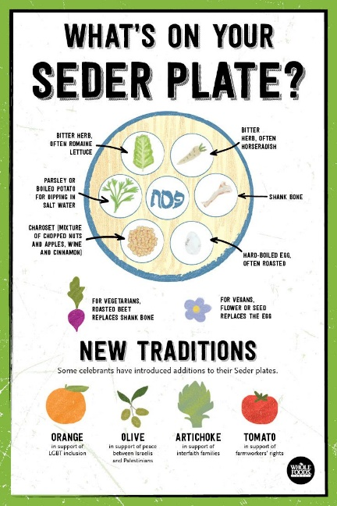
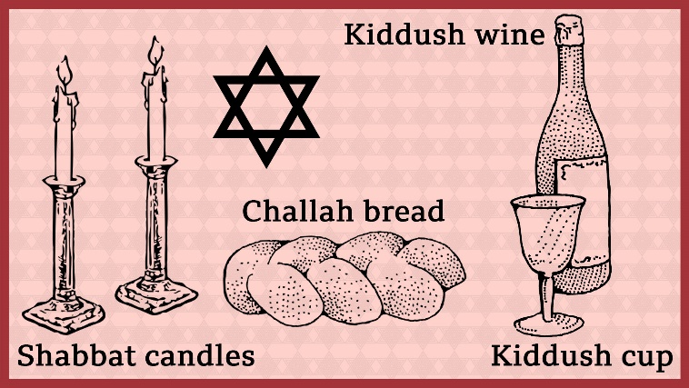
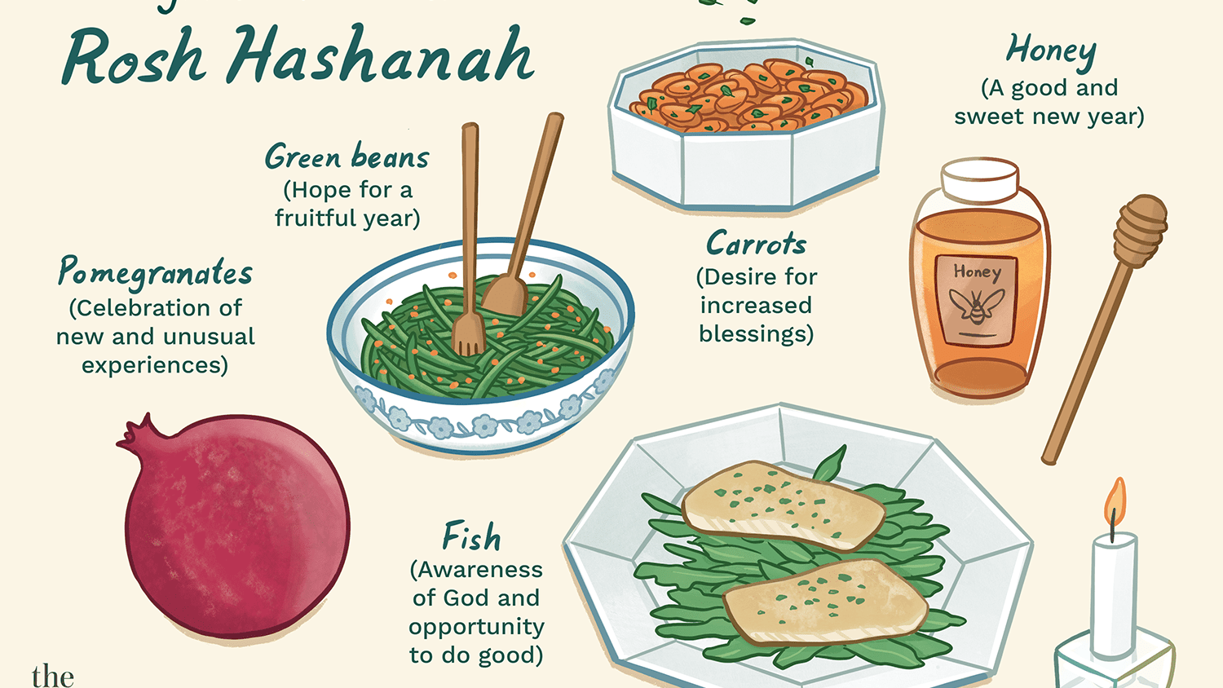
Shabbat, Pesach and Rosh Hashanah
Shabbat
Pesach
Rosh Hashanah

