Slide 1
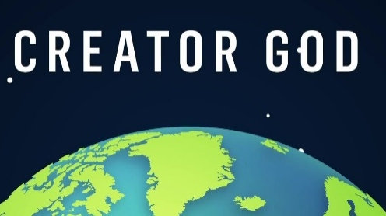
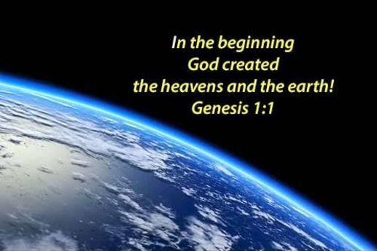
Reception Religious Education Knowledge Organiser Spring 1 Why is the word ‘God’ so special to Christians? Religious Education explores big questions about life, to find out what people believe and what difference this makes to how they live.
Key Vocabulary and Terms
Christian-A person who follows and believes in the teachings of Jesus, God and the Holy Spirit.
Bible a religious/holy book for Christians
Creator God-Christians, Jews and Muslims share the belief in their being God being the creator of life.
What we will learn
Making sense of belief
Retell stories, talking about what they say about the world, God, human beings
Making connections
Talk about things they find interesting, puzzling or wonderful and also about their own experiences and feelings about the world
Think about the wonders of the natural world, expressing ideas and feelings
Talk about what people do to mess up the world and what they do to look after it.
Understanding Impact
Say how and when Christians like to thank their Creator

Slide 2
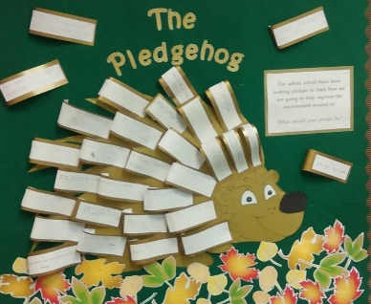
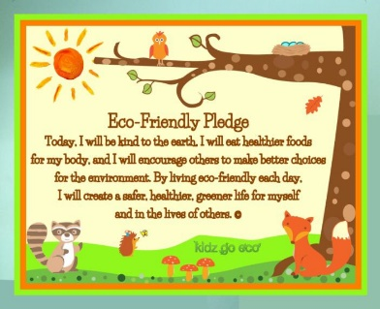
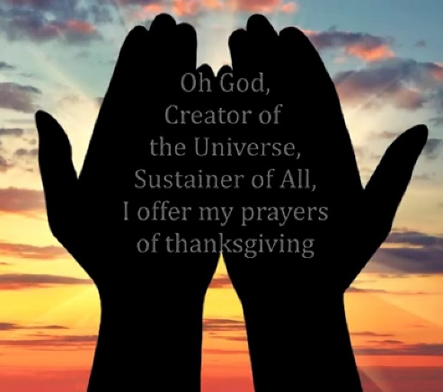
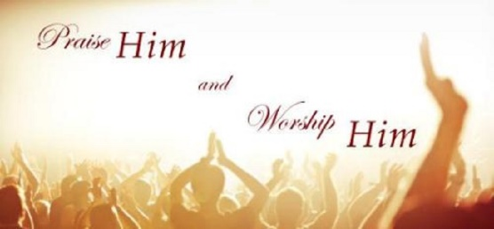
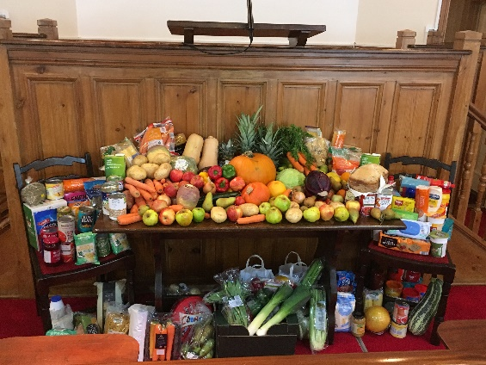
Eco pledges
Prayer and Praise to God
Harvest

