Slide 1
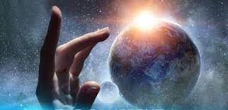
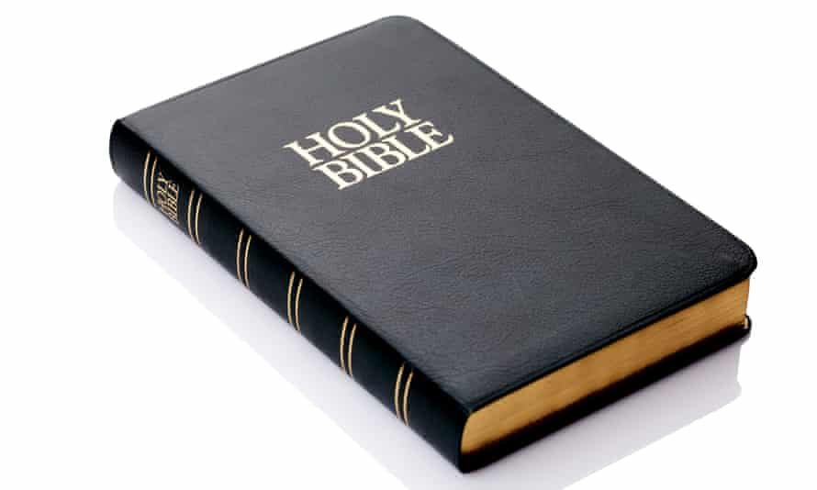
Year 3 Religious Education Knowledge Organiser Autumn 1 What do Christians learn from the Creation story?(Creation/Fall)
Key Vocabulary and Terms
Christian-A person who follows and believes in the teachings of Jesus, God and the Holy Spirit
Jewish- A person who follows and believes the teachings of Judaism and follows the scriptures of the Old Testament/Torah.
Bible-The holy book that Christians read to learn more and guide them in their beliefs..
Old Testament-The first part of the Bible, used by both Christian and Jewish people to guide their lives.
God-Jewish and Christian people believe in one God. A divine, holy being who they believe created the world.
What we will learn
Making sense of belief
Place the concepts of God and Creation on a timeline of the Bible’s ‘Big Story’.
Make clear links between Genesis 1 and what Christians believe about God and Creation.
Recognise that the story of ‘the fall’ in Genesis 3 gives an explanation of why things go wrong in the world.
Making connections
Ask questions and suggest answers about what might be important in the creation story for Christians living today, and for people who are not Christians.
Understanding Impact
Describe what Christians do because they believe God is Creator. (For example, follow God, wonder at how amazing God’s Creation is; care for the earth in some specific ways.)
Describe how and why Christians might pray to God, say sorry and ask for forgiveness

Slide 2
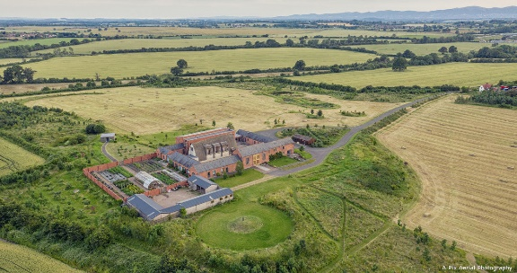
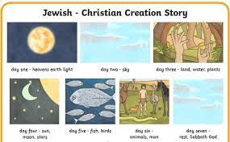
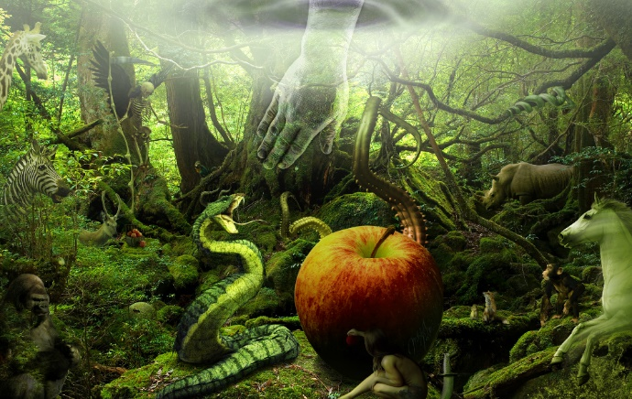
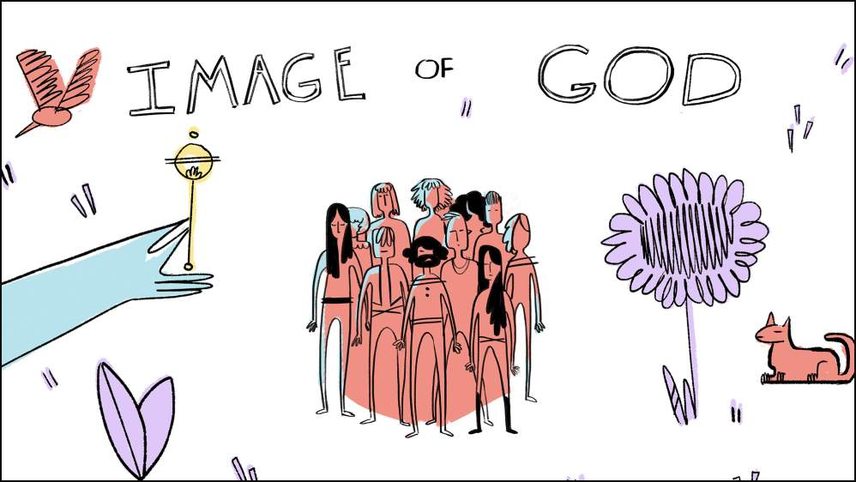
Stewards of Creation
The monks at Mucknell Abbey in Worcestershire
Christian/Jewish Creation story
Genesis 1 V 1-25
Genesis 1 v 26-31-humans made in God’s image
The Fall
Genesis 2: 15-17 and Genesis 3-the fall describes the way that Adam and Eve ‘fell’ from their close relationship with God.

