Slide 1
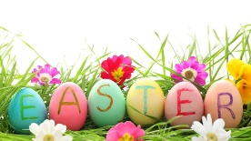
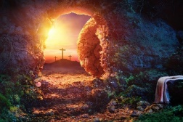
Year 2 Religious Education Knowledge Organiser
Spring 2 Why does Easter matter to Christians?
Key Vocabulary and Terms
Christian-A person who follows and believes in the teachings of Jesus, God and the Holy Spirit
Bible-The holy book that Christians read to learn more and guide them in their beliefs.
salvation-Christian belief in being rescued by God from the things they have done wrong through Jesus’s death and resurrection.
Easter-A Christian holiday that celebrates the belief in the resurrection of Christ
Jesus/Messiah/Christ-Christians believe that he is the Messiah, God in the flesh, the one who has come to save them.
resurrection-Christian belief in Jesus being ‘raised from the dead’, the third day after he died on the cross.
What we will learn
Making sense of belief
Recognise that Incarnation and Salvation are part of a ‘big story’ of the Bible
Tell stories of Holy Week and Easter from the Bible and recognise a link with the idea of Salvation (Jesus rescuing people)
Making connections
Think, talk and ask questions about whether the story of Easter only has something to say to Christians, or if it has anything to say to pupils about sadness, hope or heaven, exploring different ideas and giving a good reason for their ideas
Understanding Impact
Give at least three examples of how Christians show their beliefs about Jesus’ death and resurrection in church worship at Easter
Lent and Easter Week

Slide 2
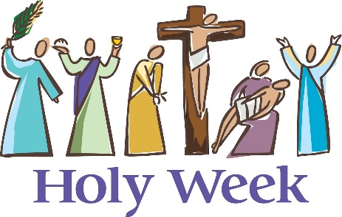
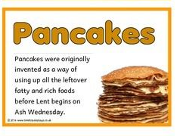
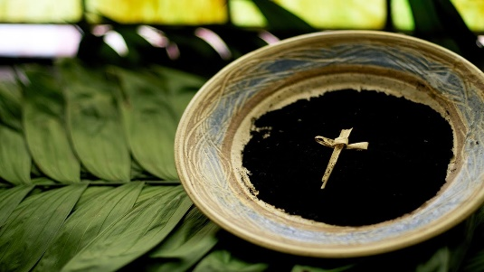
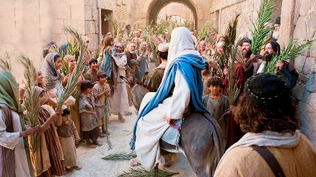
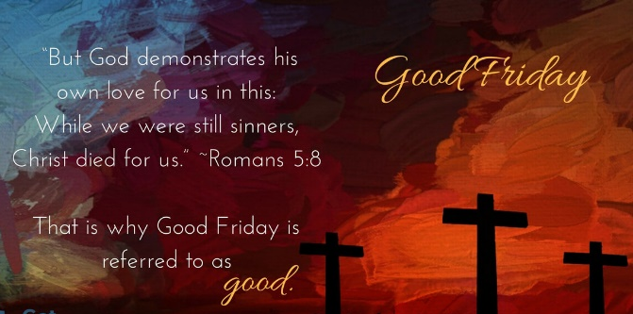
Lent and Holy Week
Shrove Tuesday The day before Ash Wednesday, traditionally a time for using up all of the sweet food items In your house before the start of Lent.
Ash Wednesday The first day of Lent, traditionally a time for Christians to pray and say sorry for the things they have done wrong and start a time of giving up certain foods/things for Lent. The day that in the Bible Jesus went into the desert to have some time on his own. While he was there the devil tried to tempt him.
Palm Sunday The first day of Holy week and in the Bible the day that Jesus was welcomed into Jerusalem while riding on a donkey and the crowds waved palm branches at him.
Good Friday A Christian holiday that remembers the day that Jesus died on a cross.

