Slide 1
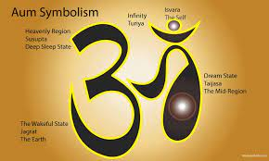
Year 6 Religious Education Knowledge Organiser
Spring 1 Why do Hindu’s try to be good?
Religious Education explores big questions about life, to find out what people believe and what difference this makes to how they live.
Key Vocabulary and Terms
Hindu-A person who follows and believes in the teachings of Hinduism
Brahman (God) Hindu belief in the ultimate being whose spirit is in everything
dharma-describes a Hindu’s whole way of life, religious and moral law-duty
moksha-release from the circle of life
karma-that actions have consequences
samsara-cycle of birth, death, rebirth
sewa-selfless service to humanity
Ahimsa-harmlessness or non-violence
Ashramas-four main stages of life
Vedas-oldest sacred Hindu text
Atman-sparkle of Brahman inside every living being
What we will learn
Making sense of belief
Identify and explain Hindu beliefs, e.g. dharma, karma, samsara, moksha, using technical terms accurately
Give meanings for the story of the man in the well and explain how it relates to Hindu beliefs about samsara, moksha, etc.
Making connections
Make connections between Hindu beliefs studied (e.g. karma and dharma), and explain how and why they are important to Hindus
Reflect on and articulate what impact belief in karma and dharma might have on individuals and the world, recognising different points of view
Understanding Impact
Make clear connections between Hindu beliefs about dharma, karma, samsara and moksha and ways in which Hindus live
Connect the four Hindu aims of life and the four stages of life with beliefs about dharma, karma, moksha, etc.
Give evidence and examples to show how Hindus put their beliefs into practice in different ways

Slide 2
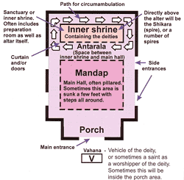
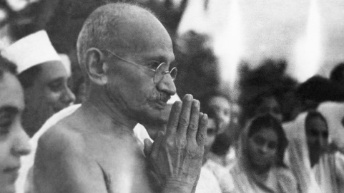
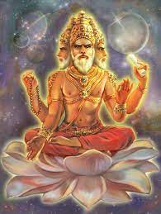
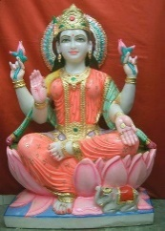
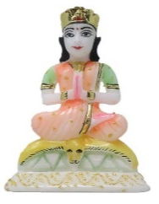
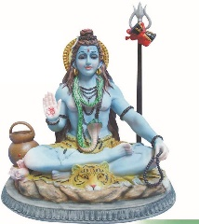
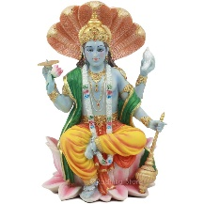

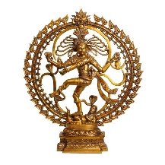
Mandir/Hindu Temple.
Different aspects or sides of God
Gandhi
Namaste-’greetings to you’
Brahma, Laksmi, Parvati, Shiva, Vishnu (left to right).
Trimurti:
Brahma (creation), Vishnu (preservation), Shiva Nataraja (destruction) (left to right)

