Slide 1
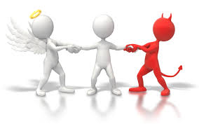
Year 5 Religious Education Knowledge Organiser
Summer 2 What matters most to Humanists and Christians?
Religious Education explores big questions about life, to find out what people believe and what difference this makes to how they live.
Key Vocabulary and Terms
Jew/Jewish-A person/people who follow the beliefs and teachings of Judaism.
God-Jews and Christians believe in one Creator God who cares for all people and created the world.
Christian-A person who follows and believes in the teachings of Christianity.
Jesus-Christian belief in God coming to earth in human form to save mankind
Bible-a religious holy book that is special to Christians, Jews and Samaritans.
humanist-a non religious person who has concern for human welfare and has the right and responsibility to shape their own lives.
atheist a person who believes there is no God
What we will learn:
Make sense of belief:
Identify and explain beliefs about why people are good and bad (e.g. Christian and Humanist)
Make links with sources of authority that tell people how to be good (e.g. Christian ideas of ‘being made in the image of God’ but ‘fallen’, and Humanists saying people can be ‘good without God’)
Understand the impact:
Make clear connections between Christian and Humanist ideas about being good and how people live
Suggest reasons why it might be helpful to follow a moral code and why it might be difficult, offering different points of view
Make connections:
Raise important questions and suggest answers about how and why people should be good
Make connections between the values studied and their own lives, and their importance in the world today, giving good reasons for their views.
Lent and Easter Week

Slide 2
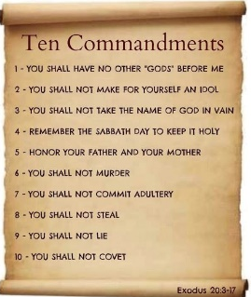
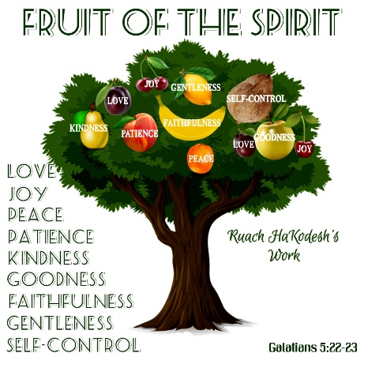
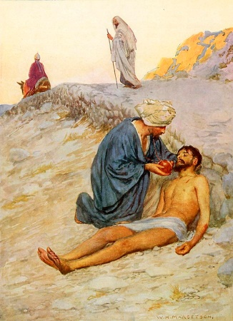
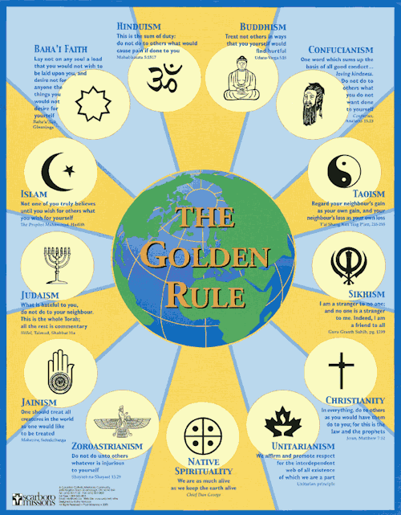
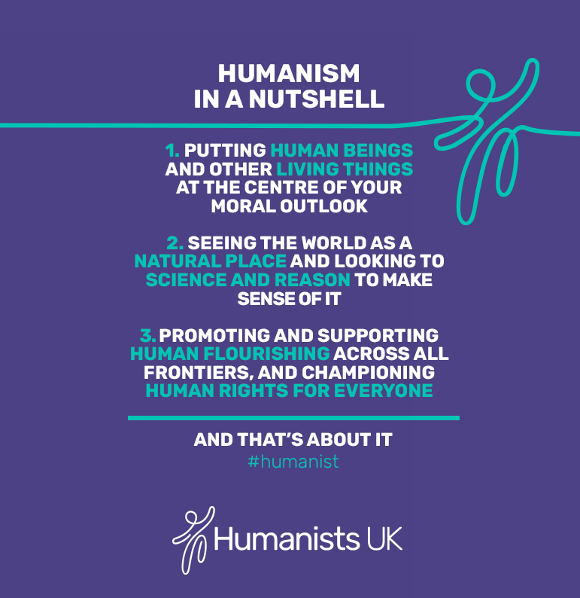
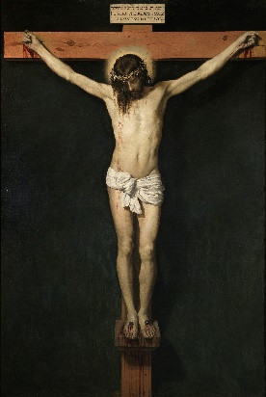
Jewish and Christian Ten Commandments
Christian values shown in the Bible
The Golden Rule
Humanism
The Good Samaritan story shows the value of love
forgiveness

