Slide 1
Year 4 Religious Education Knowledge Organiser Spring 1 What does it mean to be a Hindu in Britain today? Religious Education explores big questions about life, to find out what people believe and what difference this makes to how they live.
Key Vocabulary and Terms
Hindu-A person who follows and believes in the teachings of Hinduism
Brahman (God) Hindu belief in the ultimate being whose spirit is in everything
Puja-a worship ritual performed by Hindus
Diwali a five day festival of lights, celebrated by Hindus, Sikhs and Jains
bhajans-Hindu worship songs
diva lamp-a lamp with a flame used during worship
Aarti-light which restores darkness
dharma-describes a Hindu’s whole way of life, religious and moral law
sanatana dharma-eternal or absolute set of duties/practices for Hindus
What we will learn
Making sense of belief
Identify the terms dharma, Sanatan Dharma and Hinduism and say what they mean
Make links between Hindu practices and the idea that Hinduism is a whole ‘way of life’ (dharma)
Making connections
Raise questions and suggest answers about what is good about being a Hindu in Britain today, and whether taking part in family and community rituals is a good thing for individuals and society, giving good reasons for their ideas.
Understanding Impact
Describe how Hindus show their faith within their families in Britain today (e.g. home puja)
Describe how Hindus show their faith within their faith communities in Britain today (e.g. arti and bhajans at the mandir; in festivals such as Diwali)
Identify some different ways in which Hindus show their faith (e.g. between different communities in Britain, or between Britain and parts of India)

Slide 2
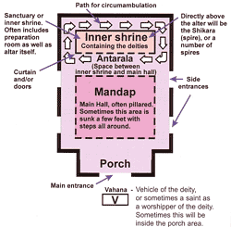
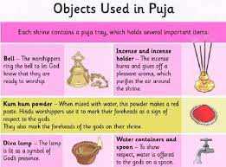
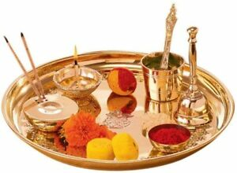
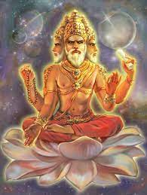
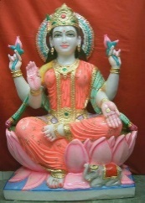
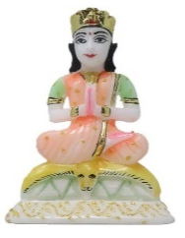
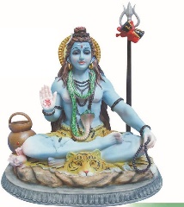
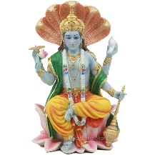
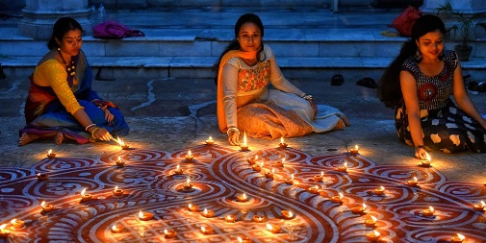
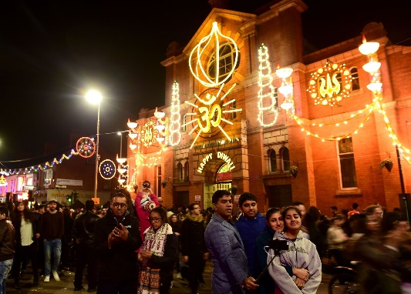
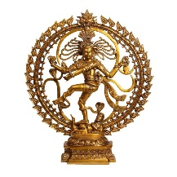
Mandir/Hindu Temple.
Different aspects or sides of God
Puja
Diwali
Brahma, Laksmi, Parvati, Shiva, Vishnu (left to right).
Trimurti:
Brahma (creation), Vishnu (preservation), Shiva Nataraja (destruction) (left to right)

