Slide 1
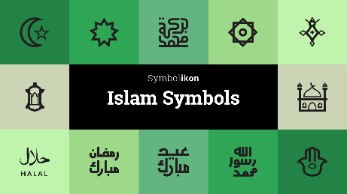
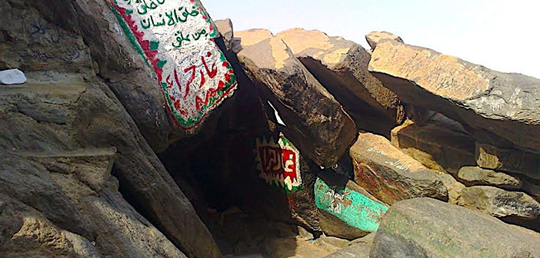
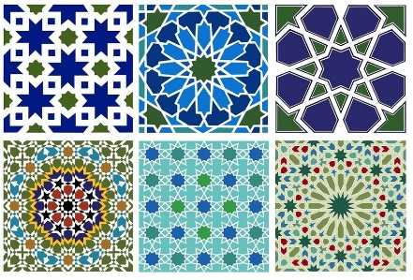
Year 2 Religious Education Knowledge Organiser
Spring 1 Who is a Muslim and how do they live-part 2?
Religious Education explores big questions about life, to find out what people believe and what difference this makes to how they live.
Key Vocabulary and Terms
Muslim a follower of the religion of Islam
Shahadah the statement that Muslims say to show what they believe
God/Allah A divine/holy being/leader that is important in the lives of Muslims
Qu’ran Muslim holy book, a guide to how Muslim's live their lives
Prophet Muhammad (PBUH-peace be upon him) Religious leader/prophet of Allah who received the words of the Qu’ran on Mt.Hira
What we will learn
Making sense of belief
Recognise the words of the Shahadah and that it is very important for Muslims
Identify some of the key Muslim beliefs about God found in the Shahadah and the 99 names of Allah, and give a simple description of what some of them mean
Give examples of how stories about the Prophet show what Muslims believe about Muhammad
Making connections
Think, talk about and ask questions about Muslim beliefs and ways of living
Talk about what they think is good for Muslims about prayer, respect, celebration and self-control, giving a good reason for their ideas
Give a good reason for their ideas about whether prayer, respect, celebration and self-control have something to say to them too
Understanding Impact
Give examples of how Muslims use the Shahadah to show what matters to them
Give examples of how Muslims use stories about the Prophet to guide their beliefs and actions (e.g. care for creation, fast in Ramadan)
Give examples of how Muslims put their beliefs about prayer into action.
Lent and Easter Week

Slide 2
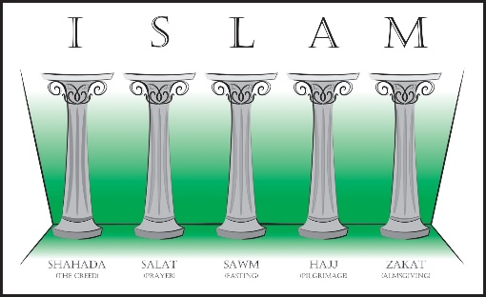
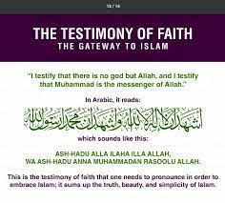
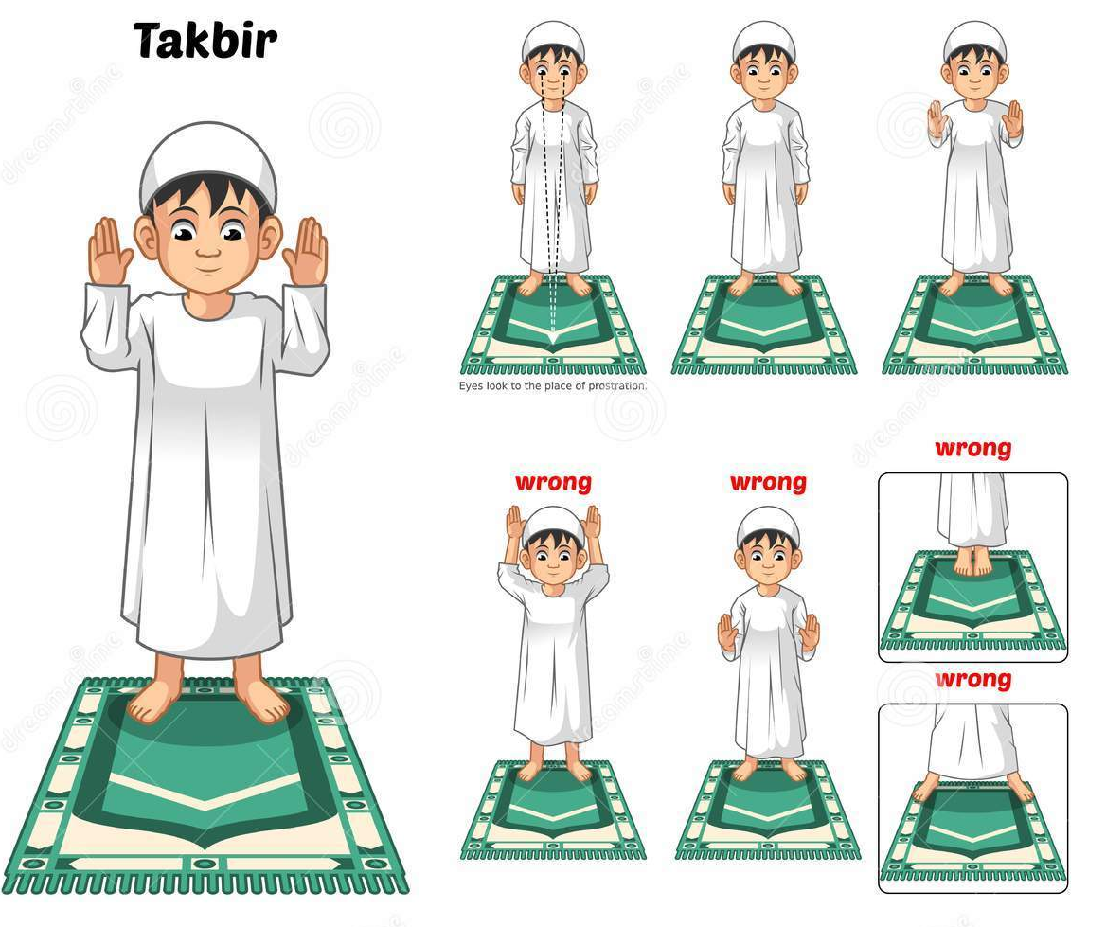
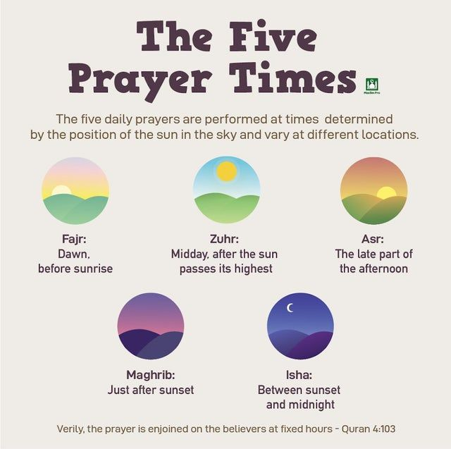
The Five Pillars of Islam-the five key practices that all
Muslims are obligated to fulfil during their lifetime. They form the foundations of Muslim belief.
Shahadah (The Pillar of Belief)
Salah-(The Pillar of Prayer)
Prayer positions and timings.

