Slide 1
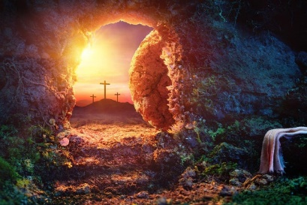
Reception Religious Education Knowledge Organiser Spring 2 Why is Easter Special to Christians?
Key Vocabulary and Terms
Christian-A person who follows and believes in the teachings of Jesus, God and the Holy Spirit
Bible-The holy book that Christians read to learn more and guide them in their beliefs.
salvation-Christian belief in being rescued by God from the things they have done wrong
Easter-A Christian holiday that celebrates the belief in the resurrection of Christ
Lent-Begins on Ash Wednesday and ends on Easter Sunday
Jesus/Messiah/Christ-Christians believe that he is the Messiah, God in the flesh, the one who has come to save them.
disciples-Jesus chose 12 men to help him share the news about Christianity.
What we will learn
Making sense of belief
Recognise and retell stories connected with celebration of Easter
Say why Easter is a special time for Christians
Making connections
Talk about ideas of new life in nature
Understanding Impact
Recognise some symbols Christians use during Holy Week, e.g. palm leaves, cross, eggs, etc., and make connections with signs of new life in nature
Talk about some ways Christians remember these stories at Easter
Lent and Easter Week

Slide 2
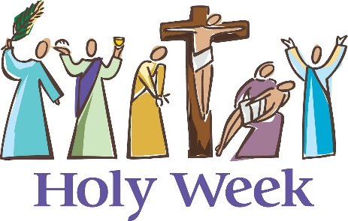
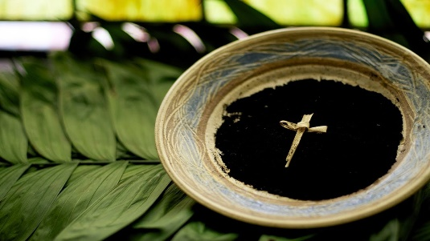
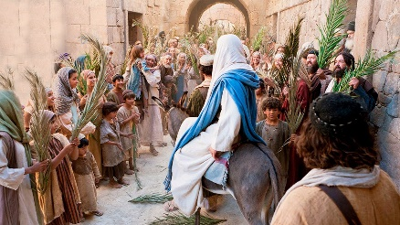
Lent and Holy Week
Shrove Tuesday The day before Ash Wednesday, traditionally a time for using up all of the sweet food items In your house before the start of Lent.
Ash Wednesday The first day of Lent, traditionally a time for Christians to pray and say sorry for the things they have done wrong and start a time of giving up certain foods/things for Lent. The day that in the Bible Jesus went into the desert to have some time on his own. While he was there the devil tried to tempt him.
Palm Sunday The first day of Holy week and in the Bible the day that Jesus was welcomed into Jerusalem while riding on a donkey and the crowds waved palm branches at him.
Good Friday A Christian holiday that remembers the day that Jesus died on a cross.

