Slide 1
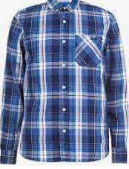
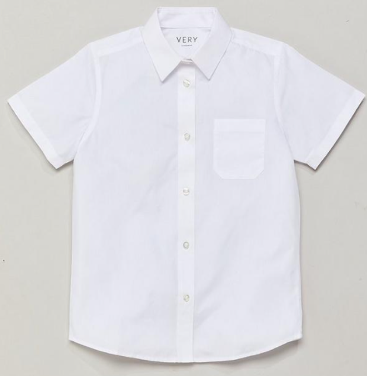



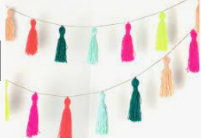
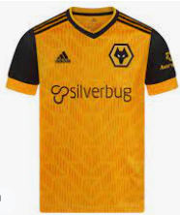
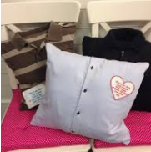
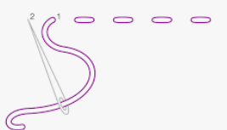
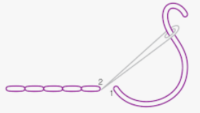
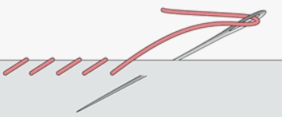
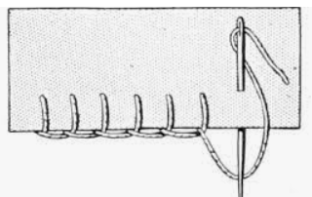
Key Vocabulary
Pattern | The template from which the parts of a garment are traced onto fabric before being cut out and assembled. Patterns are usually made of paper.
Seam | The join where two or more pieces of fabric are joined by stitching.
Seam allowance | The area between the fabric edge and the stitching line on two pieces of material being sewn together.
Upcycling | Upcycling, also known as creative reuse, is transforming unwanted products into new products.
Pin and tack | Putting a pin or a loose stitch into the pieces of fabric to keep them together whilst sewing.
Old clothing which reminds you of a memory or person
Decorations
+
=
Memory cushion
Types of stitching
Running Stitch | Back Stitch
Over Stitch | Blanket Stitch
The Design Process
Evaluate Existing Products – look at a range of products to gather my own ideas
Focused Practical Tasks – practise the skills that I will need
Design – design my own product
Make – use my design and the skills I practised to make my own product
Evaluate – try my product t see if it works and that it meets my design brief
“Funky Furnishings” Memory Cushions
Textiles
Year 6
Knowledge organiser

