Slide 1
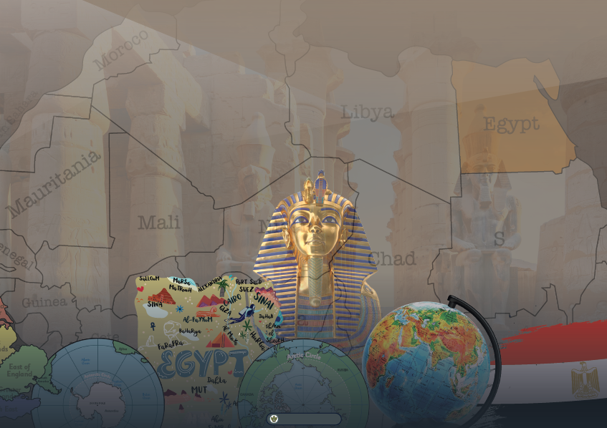

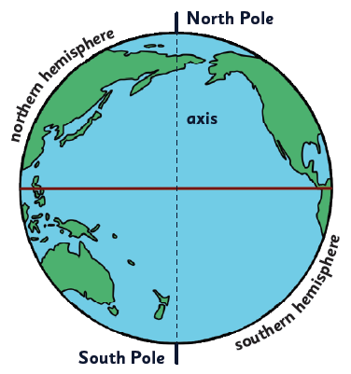
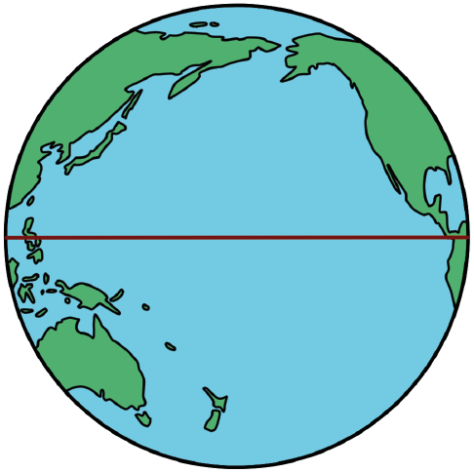
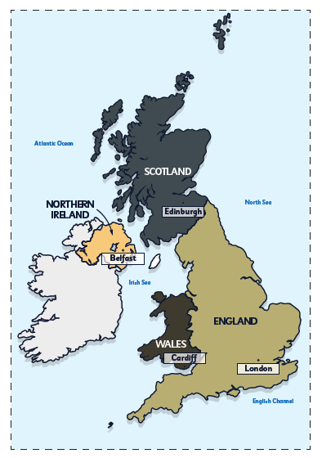
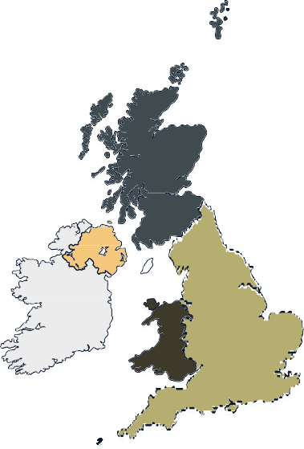

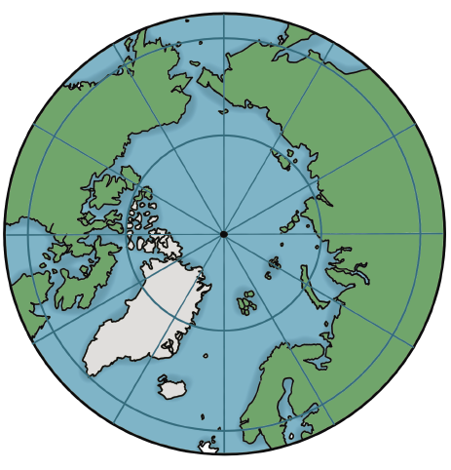
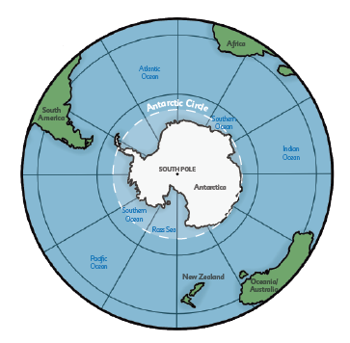
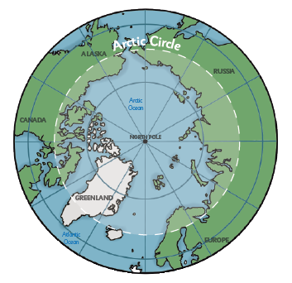
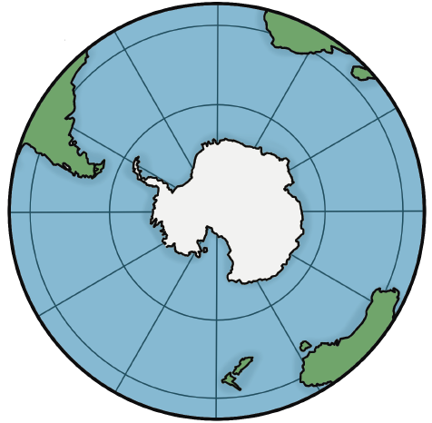
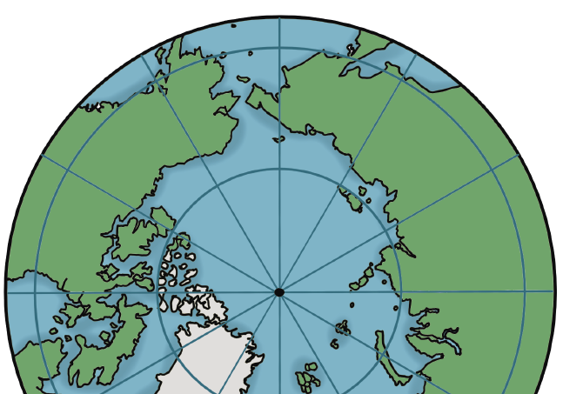
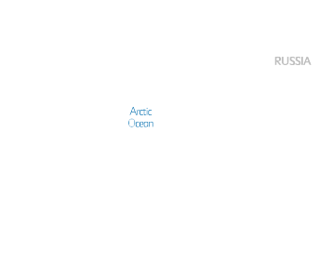

My Local Area and Luxor, Egypt
Year 2
Knowledge Organiser
The equator The climate near the equator
e
North Pole
r
e
h
Countries near the equator don't experience the four seasons like other places on Earth.
p
s
i
The Earth's equator is the imaginary line that runs around the globe’s centre. It divides the world in half.
m
e
h
n
Generally, there are two seasons in the countries along the equator, wet and dry. The wet season lasts most of the year. Along with the warmth, this creates tropical rainforests.
r
e
h
axis
t
r
o
n
The equator is an equal distance between the North and South Poles.
It is hot because it is the closest part of the Earth to the Sun.
e
r
e
h
p
s
The weather on the equator is hot all year round.
i
m
e
h
n
The United Kingdom
r
e
h
t
u
o
South Pole
s
The United Kingdom is made up of four different countries: England, Scotland, Wales and Northern Ireland. It is sometimes mistakenly called Great Britain, but Great Britain only includes England, Scotland, and Wales.
The North Pole
The South Pole
The North Pole is the northernmost point on Earth. There is no land at the North Pole, only ice. The ice is about three metres thick. The North Pole is
The South Pole is the southernmost place on Earth. It is located on land topped by more than 2700 metres of solid ice. The South Pole is much
Capital cities
Each country has a capital city where a country's government is located. It is usually
not in any country. In summer, the
Sun never sets.
the largest city.
London is England’s capital city. Belfast is Northern Ireland’s capital city. Edinburgh is Scotland’s capital city.
Cardiff is Wales’ capital city.
Four seas border the UK:
to the south by the English Channel, which separates it from continental Europe
to the east by the North Sea
to the west by the Irish Sea and the Atlantic Ocean
colder than the North Pole.
Atlantic Ocean
SCOTLAND
Africa
NORTHERN IRELAND
Edinburgh
North Sea
c
C
i
t
i
c
r
r
c
A
l
ALASKA
e
Atlantic Ocean
Belfast
Irish Sea
RUSSIA
i
t
c
c
r
C
a
i
t
r
South America
n
c
A
l
Arctic Ocean
e
Southern Ocean
NORTH POLE
SOUTH POLE
Indian Ocean
WALES
Cardiff
ENGLAND
Southern Ocean
Antarctica
London
English Channel
GREENLAND
Ross Sea
Atlantic Ocean
EUROPE
Pacific Ocean
New Zealand
Oceania/ Australia
www.grammarsaurus.co.uk

Slide 2
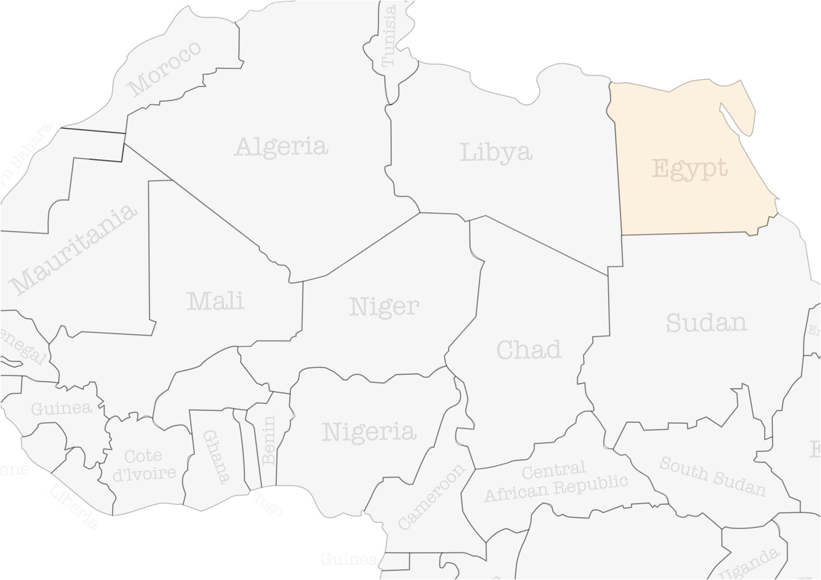
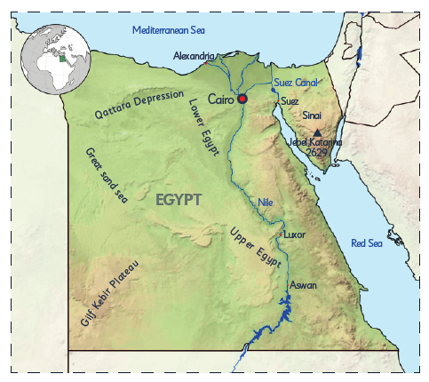
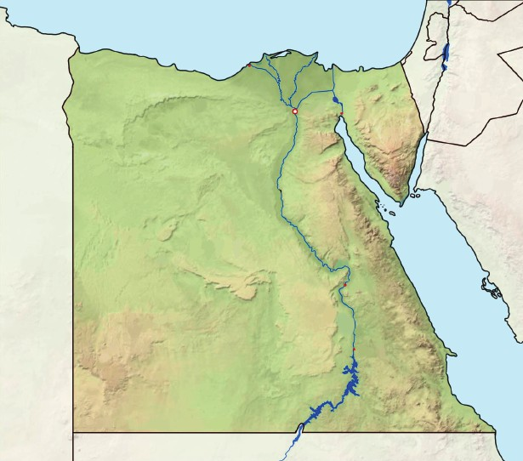
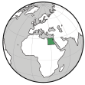
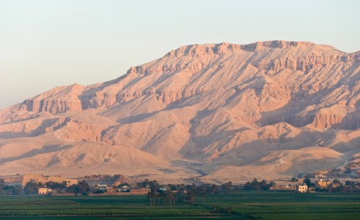
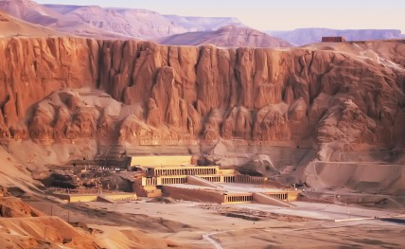
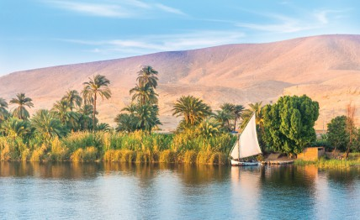
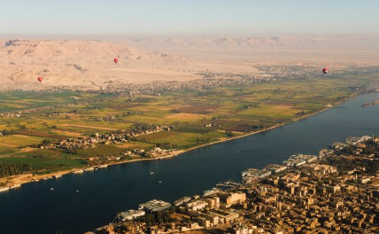
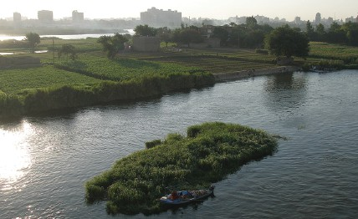
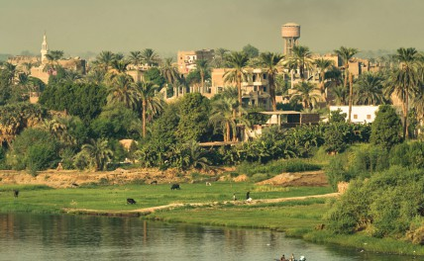
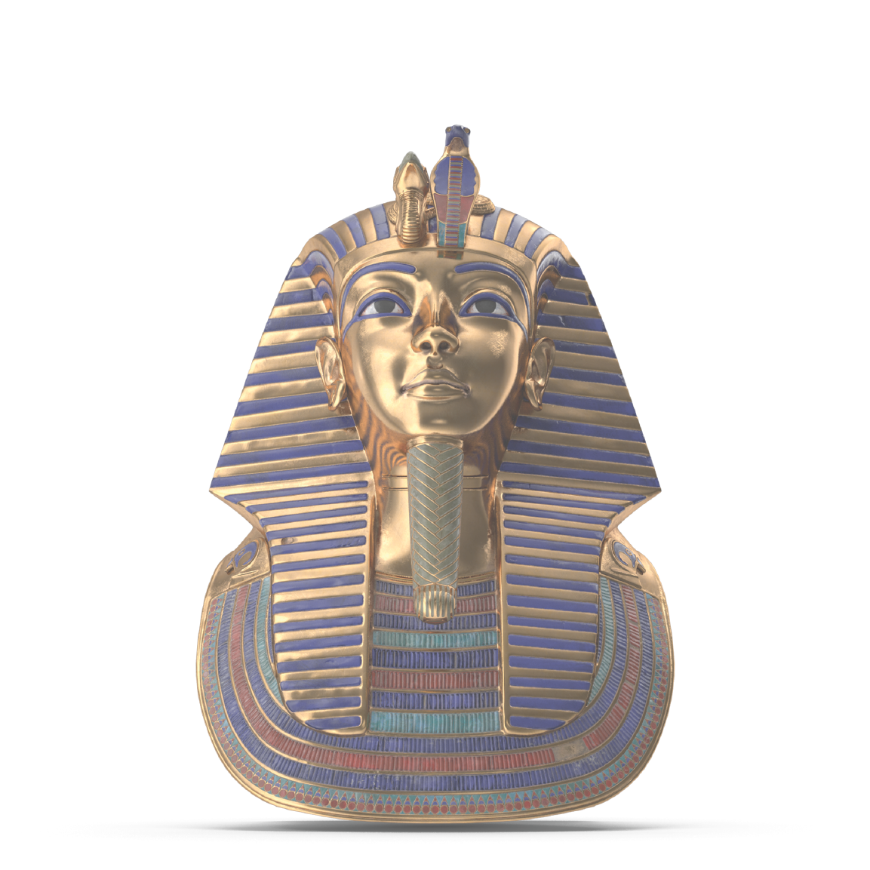
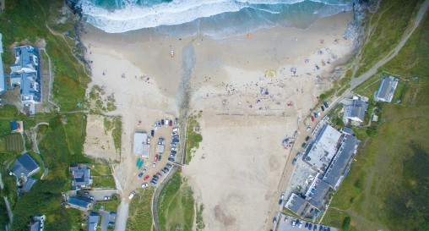
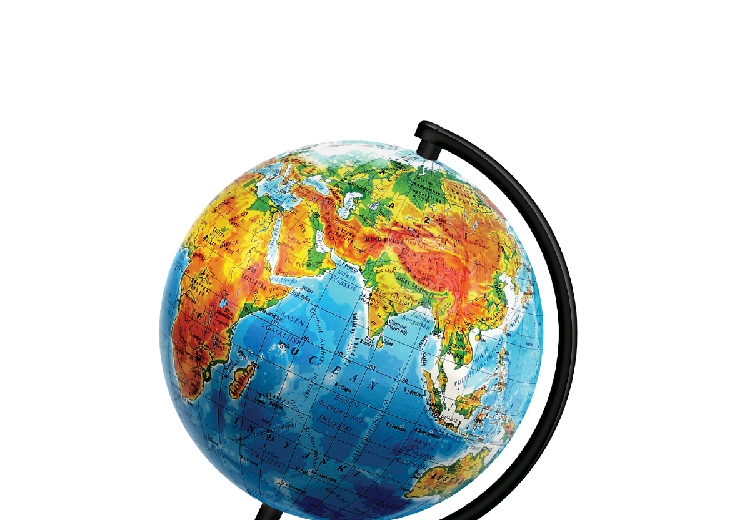
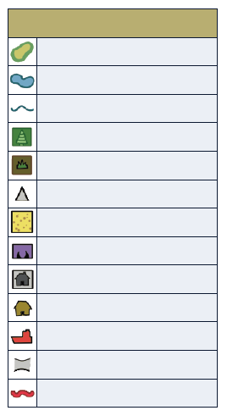
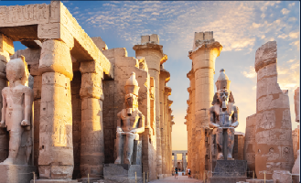
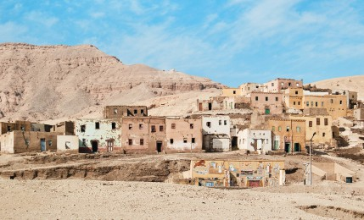
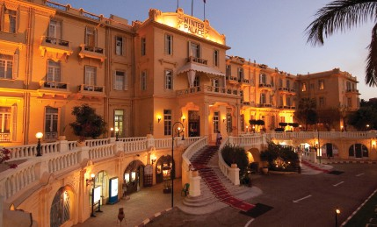

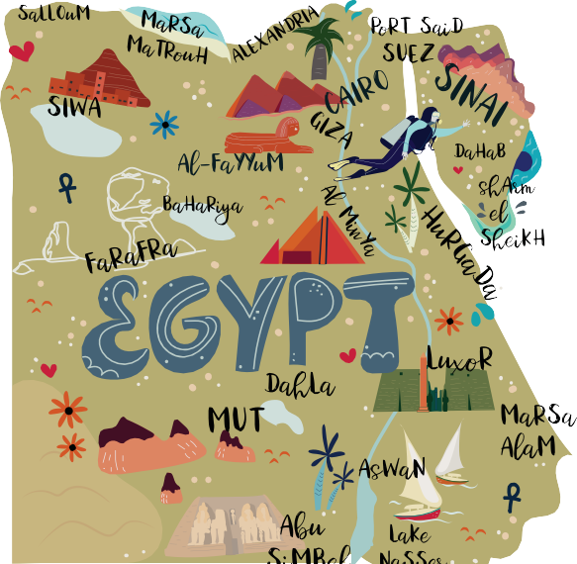

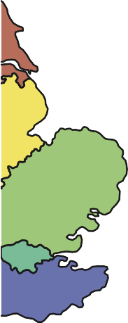



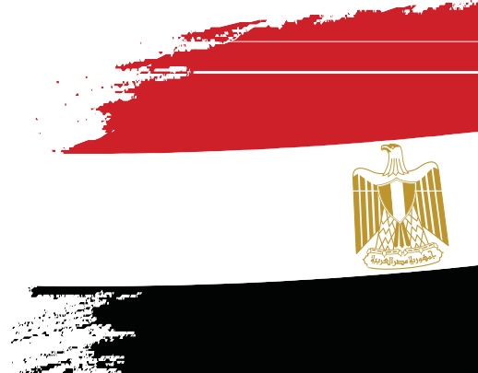

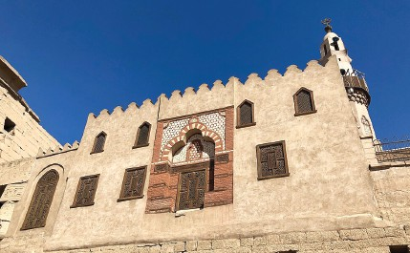
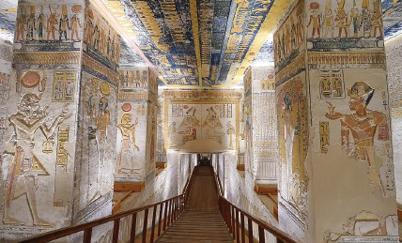
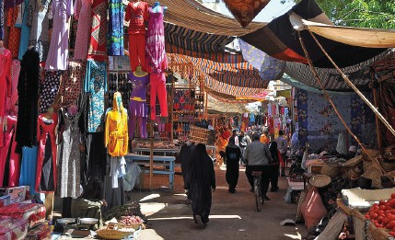
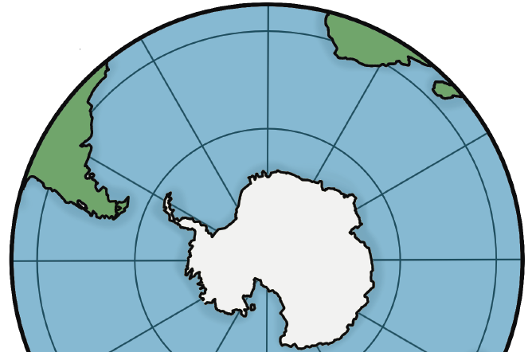




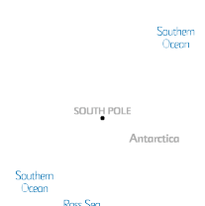





Where is Luxor, Egypt?
The physical features of Luxor
Egypt is a country in Africa. The capital city of Egypt is Cairo.
Mediterranean Sea
Luxor is a city location in the valley of the River Nile.
Alexandria
Suez Canal Suez
Sinai
n
Cairo
o
i
s
s
e
r
p
e
a
D
L
r
o
Luxor is located in Upper Egypt, and is considered a hot desert climate. This means it has two main seasons: a scorching hot season and a slightly cooler season. There is very little rainfall.
a
t
t
a
w
Q
e
r
E
Jebel Katarina 2629
g
y
G
p
r
t
e
a
t
s
a
n
d
EGYPT
s
e
Nile
a
U
Luxor
plant life
hills
cliffs
p
Red Sea
p
e
r
E
g
y
u
p
a
t
e
t
a
Aswan
l
P
r
i
b
e
K
f
il
G
Aerial photos
river
river island
floodplain
https://commons.wikimedia.org/wiki/File:Cairo,_Nile_River,_Green_islands,_Egypt.jpg
©Vyacheslav Argenberg/ http://www.vascoplanet.com/, CC BY4.0
<https://creativecommons.org/licenses/by/4.0>, via Wikimedia Commons
An aerial view is a photo taken from above. You can look at the geographical features of a place using an aerial photo.
The human features of Luxor
Luxor is famous for being the world’s ‘greatest open air museum’ where you will find the ruins of the
ancient city of Thebes.
Map symbols
Key
 | contour lines
 | lake
 | river
 | forest
 | moorland
 | mountain peak
 | beach
 | cliffs
 | houses
 | log cabin
 | ferry
 | bridge
 | road
Map symbols are pictures, drawings or even letters that can be used on maps to represent things in real life. They make it easier to read maps.
d
r
temple
houses
hotel
Map key
ds
A map key gives the map reader information about
each symbol displayed on the map. It is usually in a box and found somewhere in the corner of the map.
England
Greater
mosque
tomb
market
London
https://commons.wikimedia.org/wiki/File:Abu_Haggag_Mosque,_Luxor_Temple, https://commons.wikimedia.org/wiki/File:Tomb_of_Ramses_V_VI_in_Valley
https://commons.wikimedia.org/wiki/File:Luxor_Souq_R01.jpg Marc Ryckaert(MJJR), CC BY 3.0
<https://creativecommons.org/licenses/by/3.0>, via Wikimedia Commons
_Luxor,_LG,_EGY_(48009742147).jpg
Warren LeMayfrom Chicago, IL, United States, CC0, via Wikimedia Commons
_of_the_Kings_on_West_Bank_of_Luxor_Egypt.jpg
Tim Adams, CC BY 3.0 <https://creativecommons.org/licenses/by/3.0>, via Wikimedia Commons
www.grammarsaurus.co.uk

Slide 3

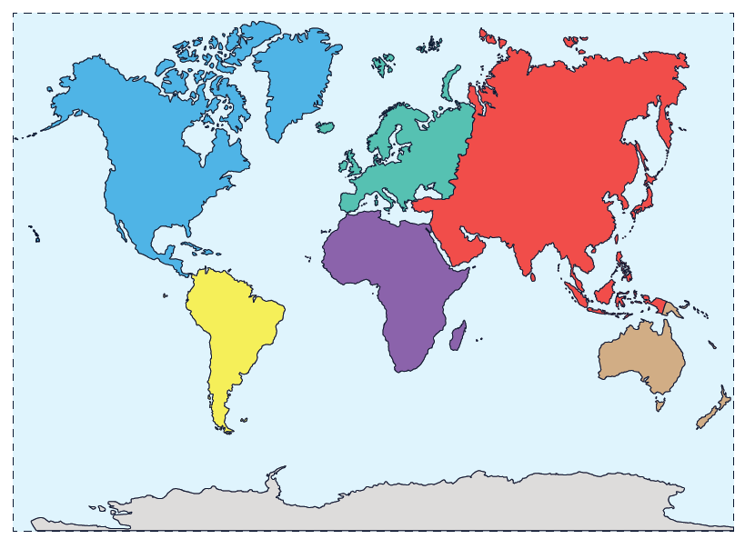
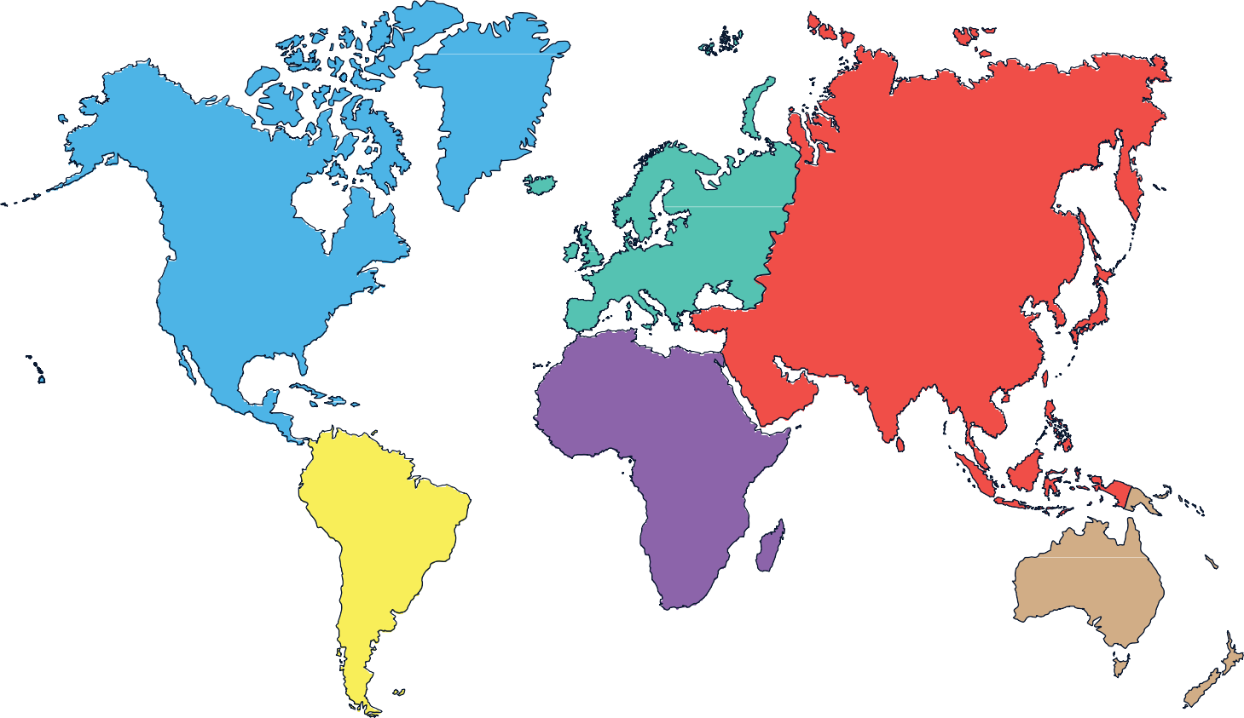







Continents and Oceans of the World
Arctic Ocean
The world is divided into big pieces of land called continents.
There are seven main continents: North
America, South America, Europe, Asia, Africa, Oceania/Australia, and Antarctica. Each continent has its own countries, animals, and people.
Asia
North America
Atlantic Ocean
Europe
Pacific Ocean
Pacific Ocean
Did you know that Oceania is considered a
region rather than a continent? When people refer to Oceania, they’re grouping the continent of Australia with nearby countries and islands in the Pacific, like New Zealand and the Pacific Islands.
Africa
South America
Indian Ocean
Atlantic Ocean
Oceania/ Australia
Pacific Ocean
The world has big areas of water called oceans.
d
r
Southern Ocean
Antarctica
There are five oceans: the Pacific Ocean,
the Atlantic Ocean, the Indian Ocean, the Southern Ocean, and the Arctic Ocean.
ds
East of England
Greater London
www.grammarsaurus.co.uk

