Slide 1

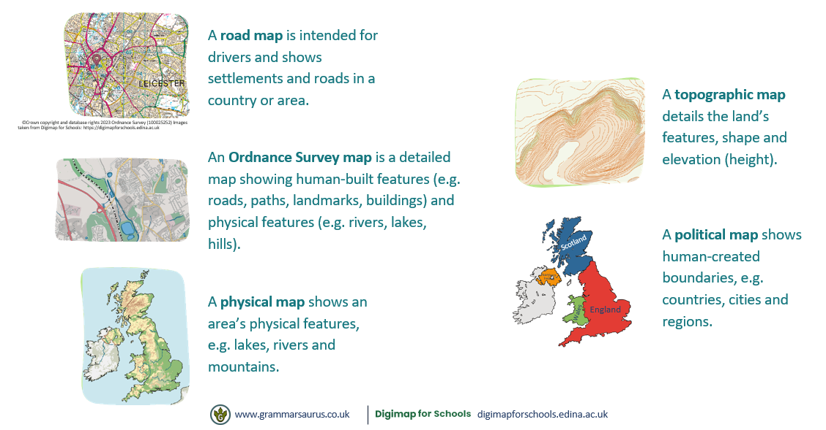
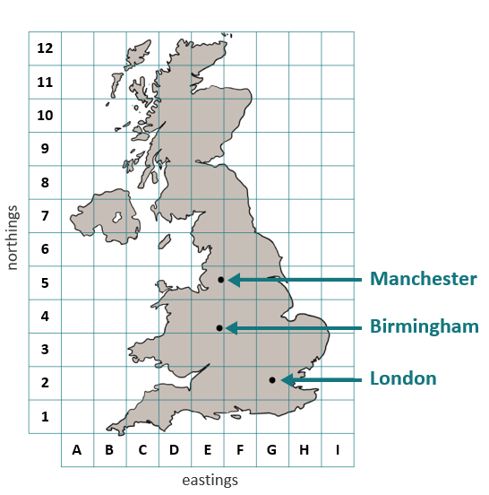

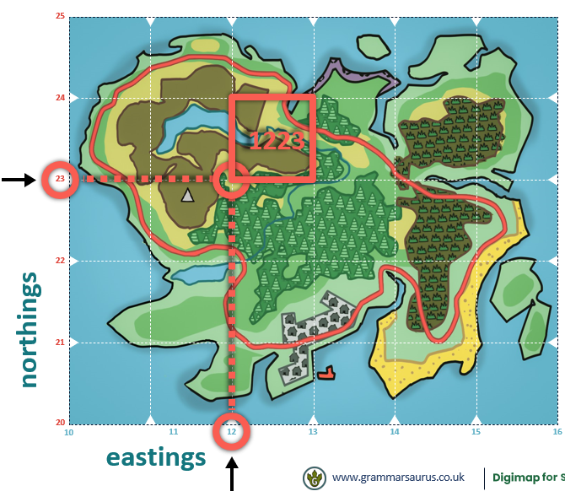
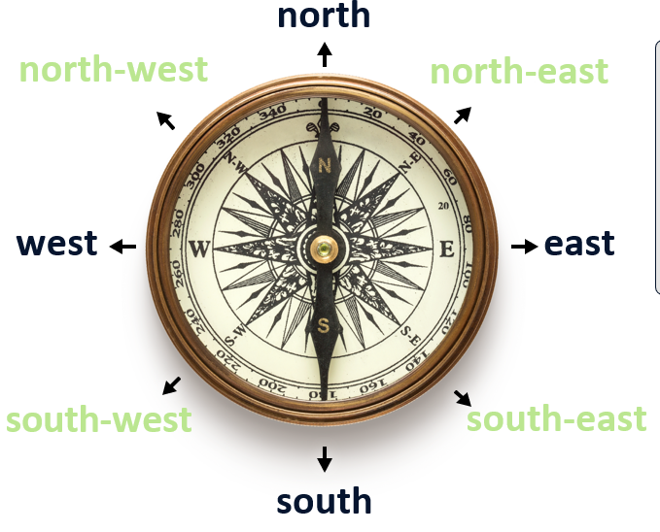
My Locality - Birmingham
Year 4
Knowledge Organiser
Using a grid code
.
The eastings are along the horizontal axis.
The northings are on the vertical axis.
Always use the easting first –
Remember the phrase – Along the corridor, then up the stairs. .
Different types of map
Cardinal Points
Grid references
Grid reference:
1223

Slide 2
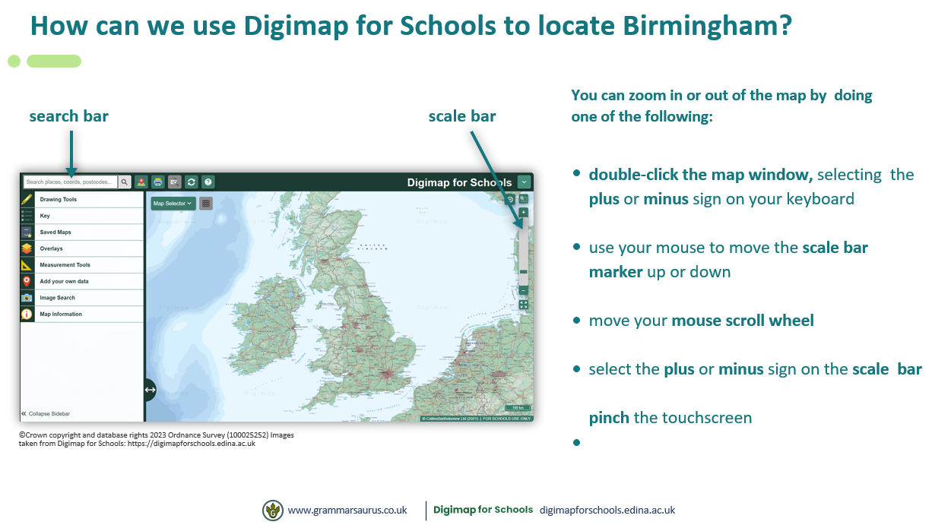
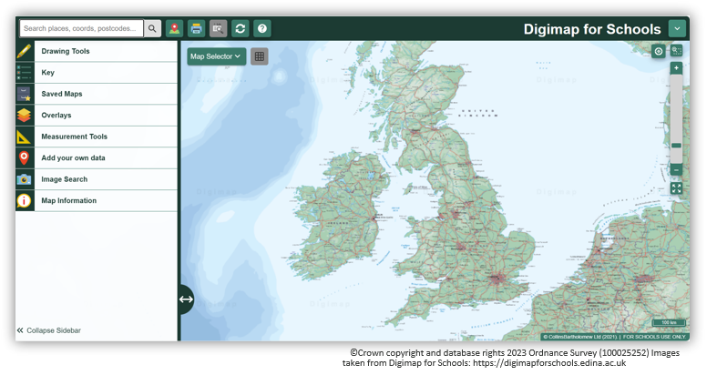
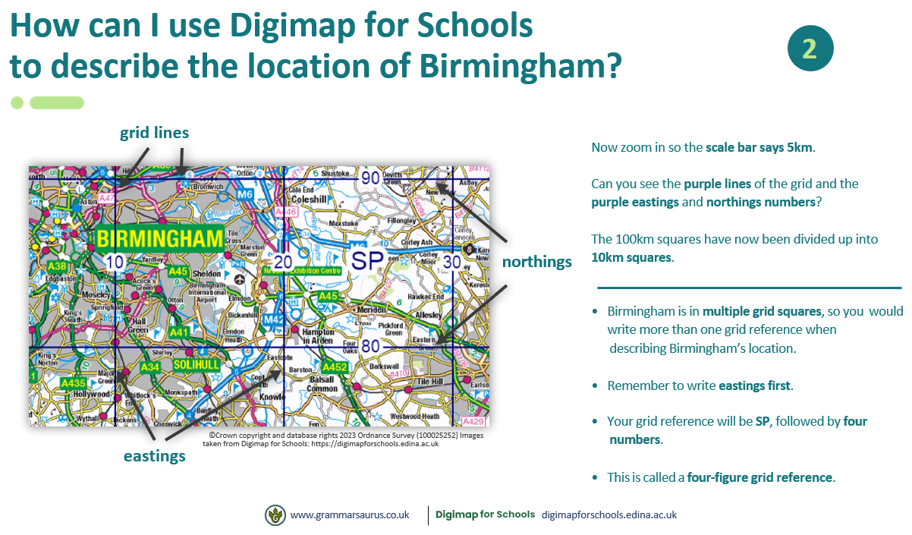
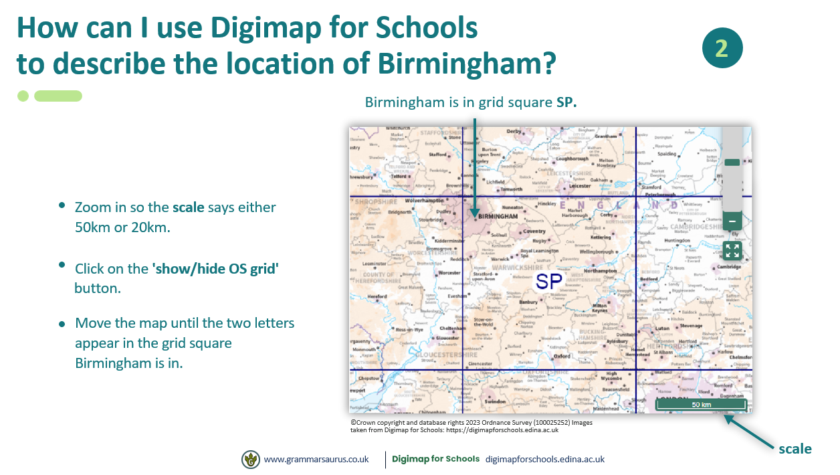
Digimaps to locate Birmingham
.
. .

Slide 3
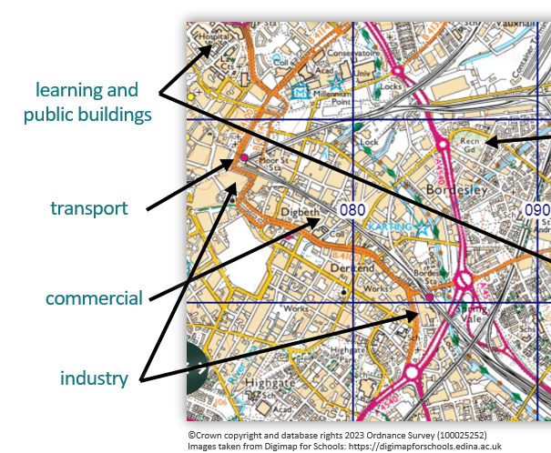
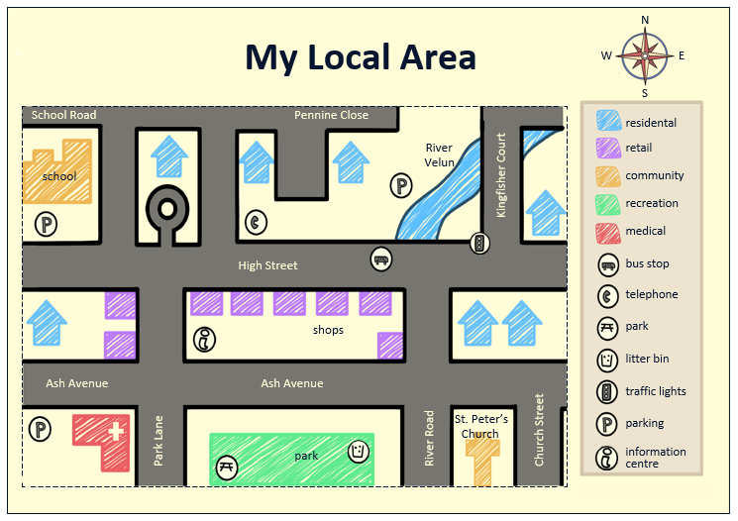
Geographical features
Geographical features:-
Houses
Roads
Schools
Places of worship
Parks
Shops
Restaurants, cafes, bars and pubs
Medical centre
Industrial buildings
.
. .
Land use:-
Residential – places where people live, e.g. houses, flats
Commercial – places that sell goods or services, e.g. shops, banks, offices
Industrial – places that build, make or store goods, e.g. factories, warehouses
Recreational/open spaces – places where people go to enjoy themselves, exercise or relax, e.g. parks, rivers and restaurants.
Transport – a system of conveying people or goods from place to place including buildings/spaces used to facilitate this e.g. roads, railways, stations, car parks
Learning and public buildings – places where people go to receive educations or occupied by public authority and frequently visited by the public.
Land Use
Sketch Maps

