Slide 1
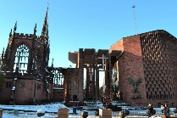
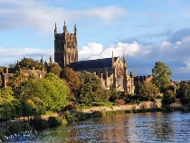
Year 5 Religious Education Knowledge Organiser
Unit 1 What does it mean for Christians to believe that God is holy and loving? (God) and threading through this year-’What can be done to reduce racism?’
Religious Education helps pupils to make sense of religion and worldviews, reflecting on
their own ideas and ways of living
Key Theological Vocabulary Christian-A person who follows and believes in the teachings of Jesus, God and the Holy Spirit
God-Christian people believe in one God. A divine, holy and loving being who they believe created the world.
.Bible-the words/writings in a book that Christians use to guide their lives
worship-for Christians worship is them expressing their thanks/feelings to God through prayer, songs and words.
Cathedrals Medieval Christians built cathedrals ‘to the glory of God.’
What we will learn
Making sense of belief
Identify some different types of biblical texts, using technical terms accurately.
Explain connections between biblical texts and Christian ideas of God, using theological terms.
Making connections
Weigh up how biblical ideas and teachings about God as holy and loving might make a difference in the world today, developing insights of their own
Understanding Impact
Make clear connections between Bible texts studied and what Christians believe about God, for example, through how cathedrals are designed.
Show how Christians put their beliefs into practice in worship
Omnipotent. God has all power. ...
Omniscient. God is all knowing. ...
Omnipresent. God is present in all places and at all times

Slide 2
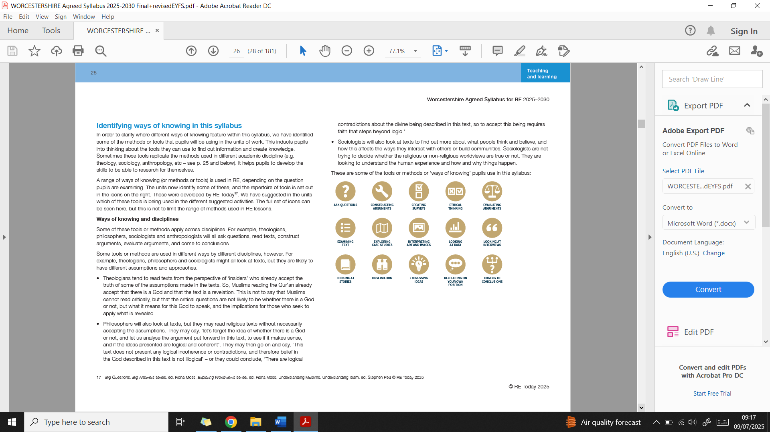
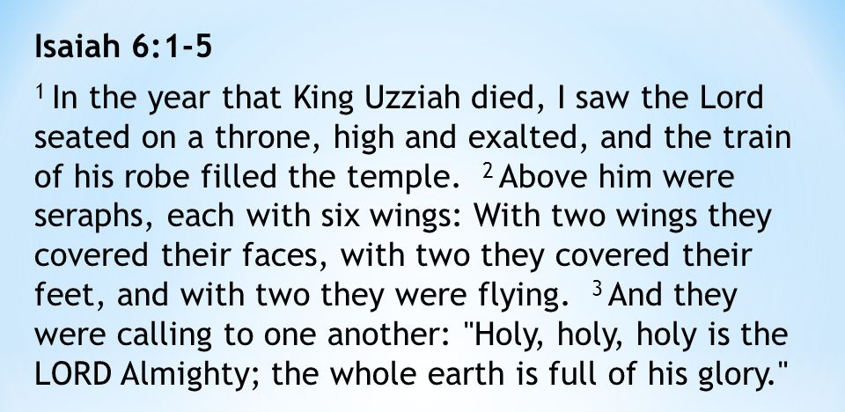
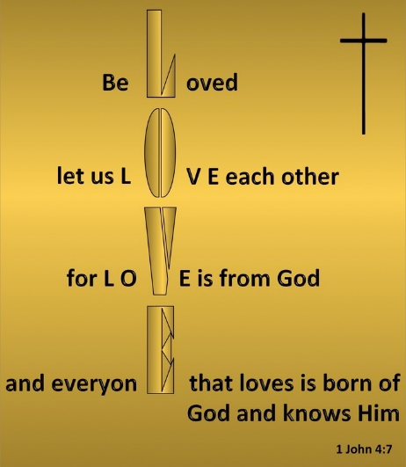
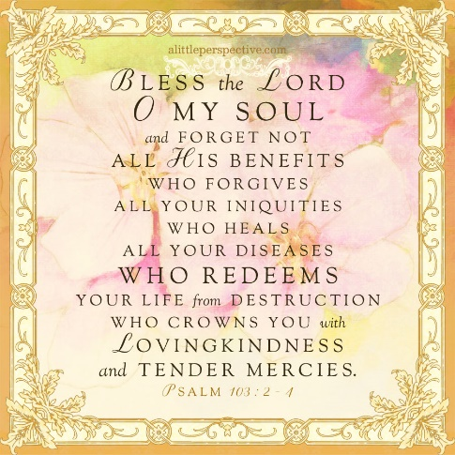
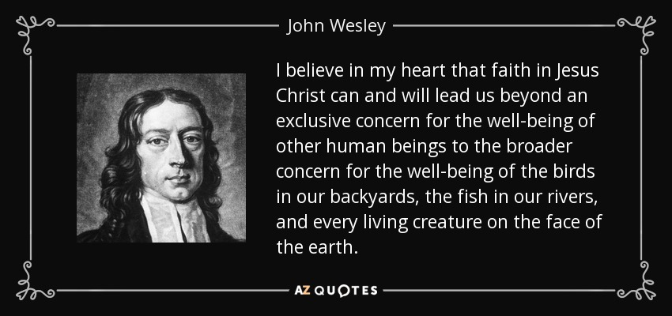
Ways of Knowing:
Lens used
Being Theologians with Thea and Theo
Being Human and Social scientists with Hunter and Sofia
Being Philosophers with Phoebe and Pharell

