Slide 1
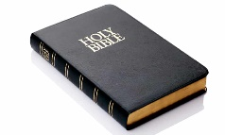
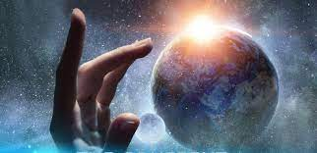
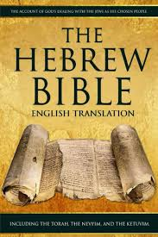
Year 3 Religious Education Knowledge Organiser
Unit 1 What do Christians learn from the Creation story?(Creation/Fall)
Religious Education helps pupils to make sense of religion and worldviews, reflecting on
their own ideas and ways of living
Key Theological Vocabulary
Christian-A person who follows and believes in the teachings of Jesus, God and the Holy Spirit
Jewish- A person who follows and believes the teachings of Judaism and follows the scriptures of the Old Testament/Torah/Hebrew Bible.
Bible-The holy book that Christians read to learn more and guide them in their beliefs..
Old Testament-The first part of the Bible, used by both Christian and Jewish people to guide their lives.
God-Jewish and Christian people believe in one God. A divine, holy being who they believe created the world.
creation in a religious sense it is God’s action of bringing the universe into being.
creator a person or thing that brings something into existence
temptation the desire to do something, especially something wrong or unwise
sin an immoral act against God (divine law)
What we will learn
Making sense of belief
Place the concepts of God and Creation on a timeline of the Bible’s ‘Big Story’.
Make clear links between Genesis 1 and what Christians believe about God and Creation.
Recognise that the story of ‘the fall’ in Genesis 3 gives an explanation of why things go wrong in the world.
Making connections
Ask questions and suggest answers about what might be important in the creation story for Christians living today, and for people who are not Christians.
Understanding Impact
Describe what Christians do because they believe God is Creator. (For example, follow God, wonder at how amazing God’s Creation is; care for the earth in some specific ways.)
Describe how and why Christians might pray
to God, say sorry and ask for forgiveness

Slide 2
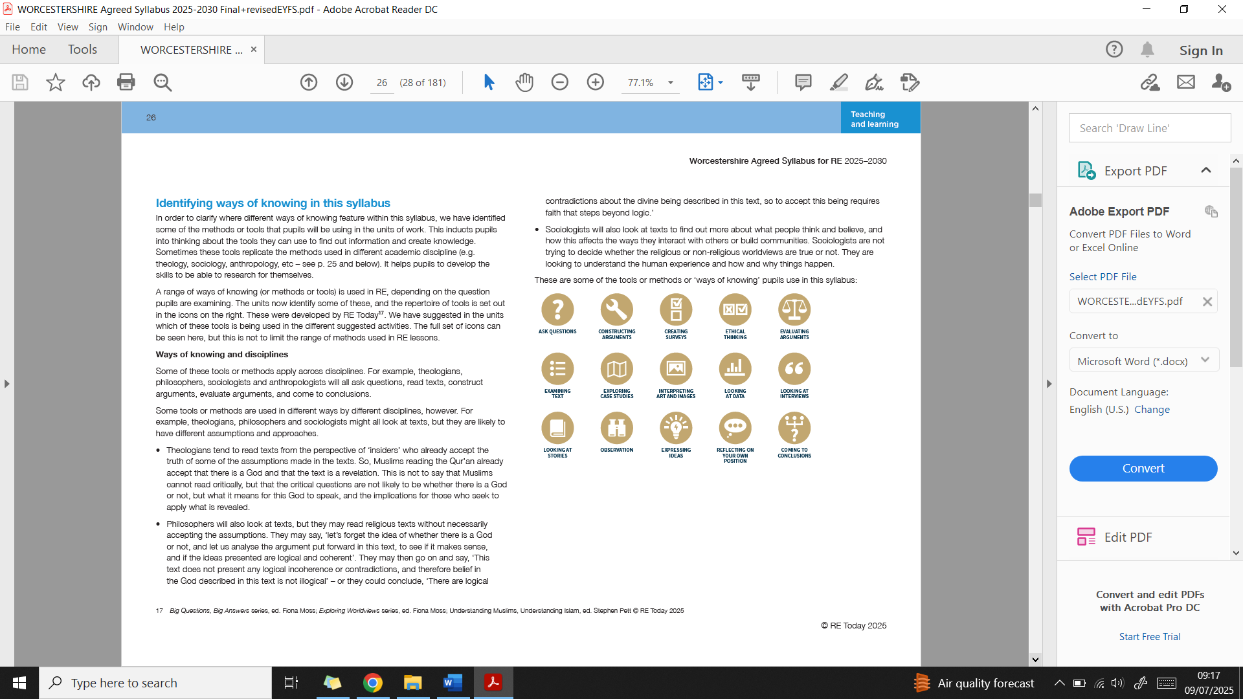
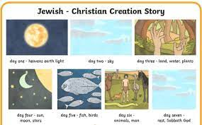
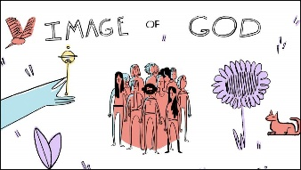
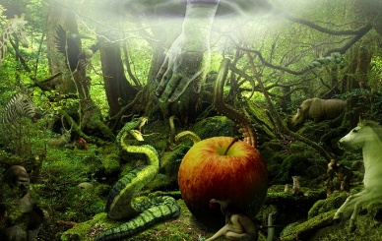
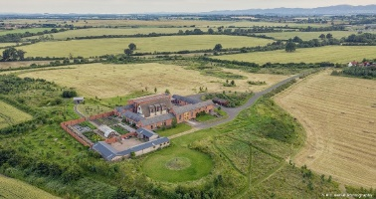
Ways of Knowing:
Lens used
Genesis 1
Genesis 2 and 3
Stewards of Creation
Being Theologians with Thea and Theo
Being Human and Social scientists with Hunter and Sofia
Genesis 2: 15-17 and Genesis 3-the fall
describes the way that Adam
and Eve ‘fell’ from their close
relationship with God.
Being Philosophers with Phoebe and Pharell
The monks at Mucknell Abbey in Worcestershire

