Slide 1
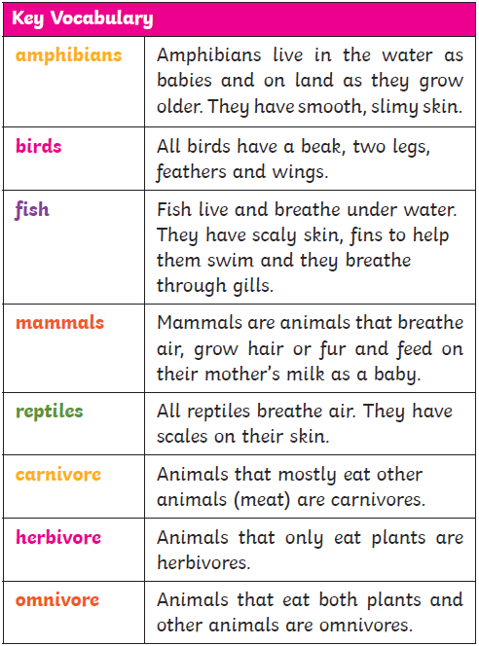
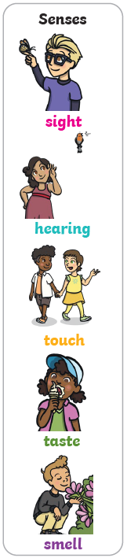
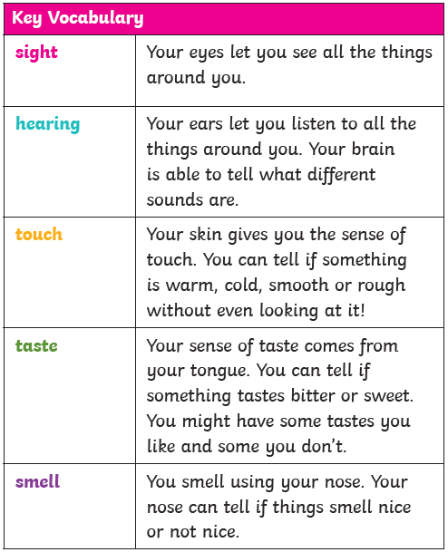
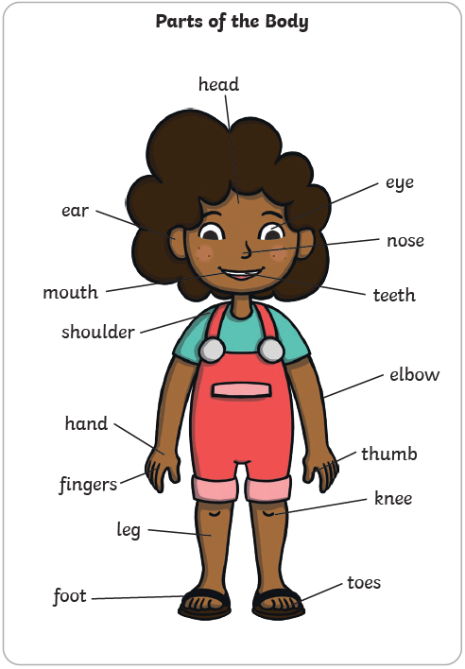
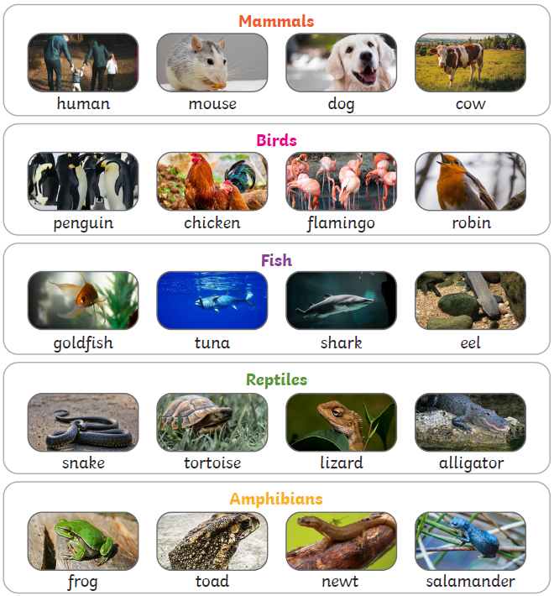
Year 1
‘Animals’
Knowledge Organiser
Key Skills (Working Scientifically)
Identifying and classifying
Observing closely to answer questions (using simple equipment)
Asking simple questions and recognising they can be answered in different ways
Performing simple tests and gathering data

