Slide 1
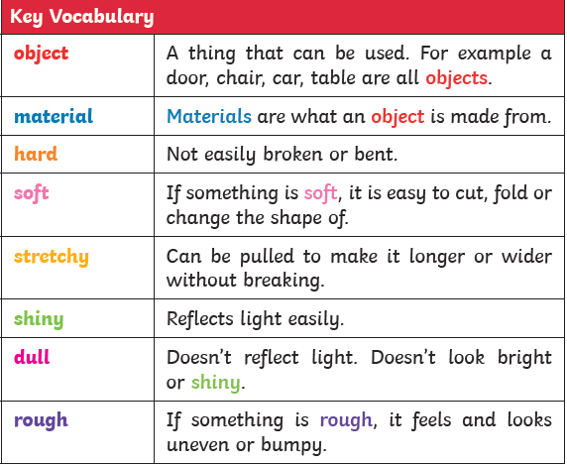
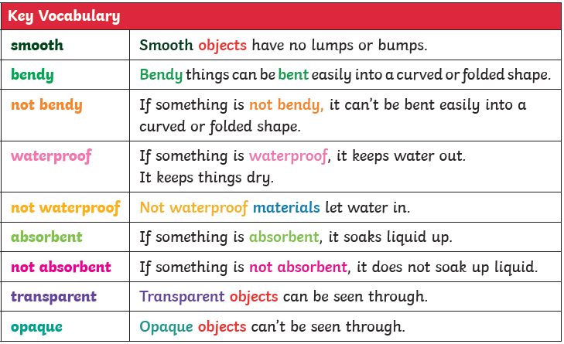
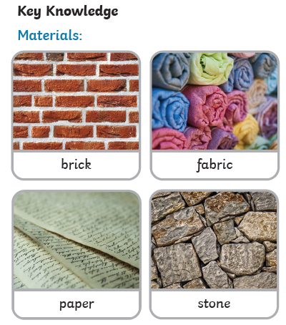
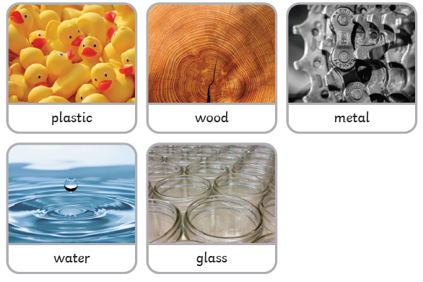

Year 1
‘Materials’ Knowledge Organiser
Key Skills (Working Scientifically)
Identifying and classifying materials and objects
Using observations to answer questions
Performing simple tests
Gather data in simple tests

