Slide 1
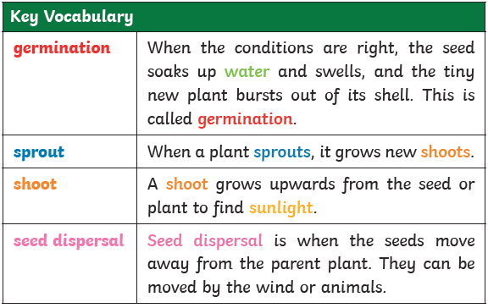
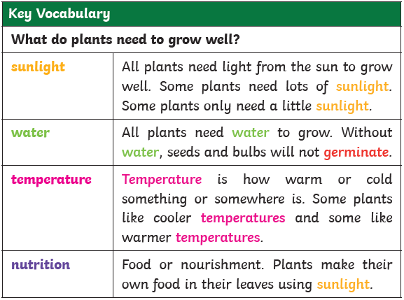
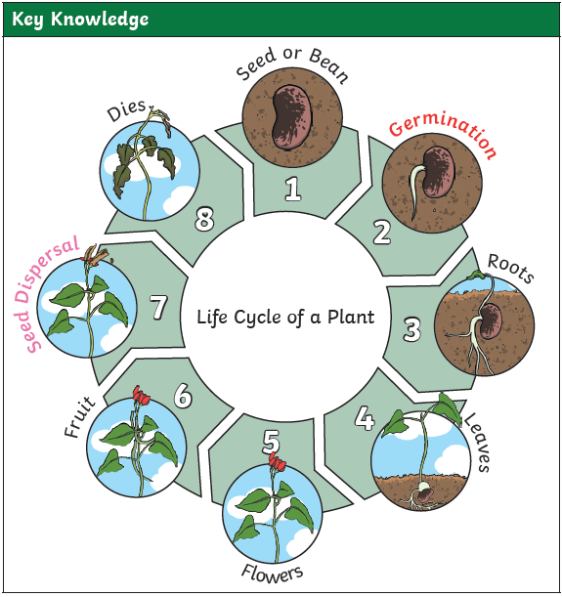
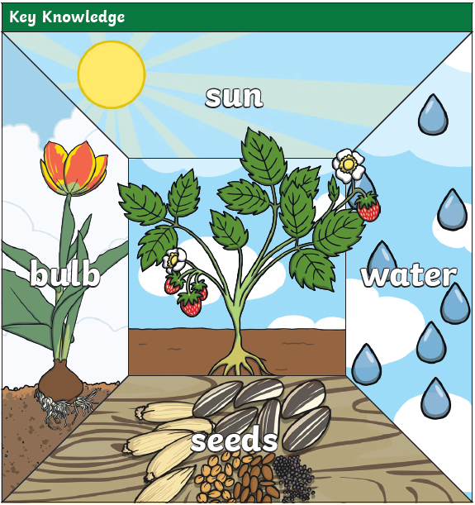
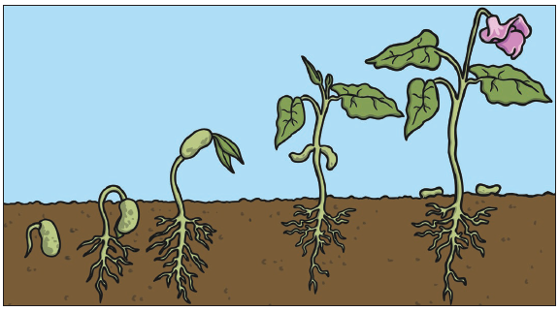
Key Skills (Working Scientifically)
Ask simple questions and recognise they can be answered in different ways
Using observations to answer questions (using simple equipment)
Performing simple tests
Gathering and recording data to answer questions
Year 2
‘Plants’
Knowledge Organiser

