Slide 1
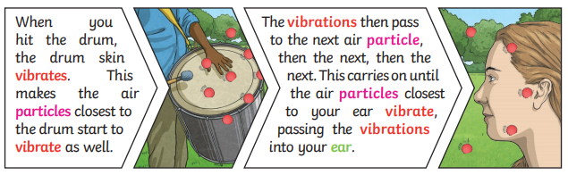
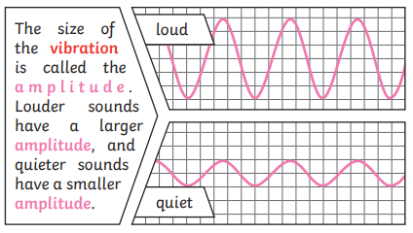
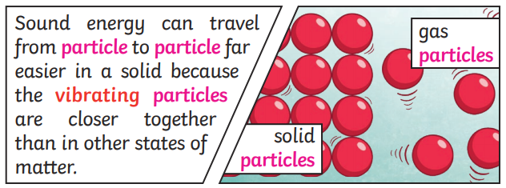
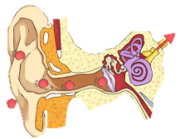
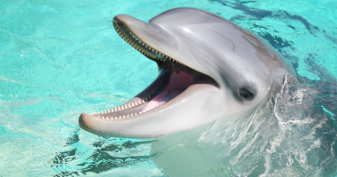

Year 4 | Science | Sound
Key Vocabulary
1 | Vibration | A movement backwards and forwards.
2 | Sound wave | Vibrations travelling from a sound source.
3 | Volume | The loudness of a sound.
4 | Amplitude | The size of a vibration. A larger amplitude = a larger sound.
5 | Pitch | How low or high a sound is.
6 | Ear | An organ used for hearing.
7 | Particles | Solids, liquids and gases are made of particles. They are so small we are unable to see them.
8 | Distance | The measurement of length between two points.
Key Knowledge
1 | Sound can travel through solids, liquids and gases. Sound travels as a wave, vibrating the particles in the medium it is travelling in.
2 | Sound cannot travel through a vacuum.
3 | Sound is a type of energy, Sounds are created by vibrations. The louder the sound, the bigger the vibration.
4 | Pitch is a measure of how high or loud a sound is. A whistle being blown creates a high-pitched sound. A rumble of thunder is an example of a low-pitched sound.
5 | Inside your ear, the vibrations hit the eardrum and are then passed to the middle and then the inner ear. They are then changed into electrical signals and sent to your brain. Your brain tells you that you are hearing sound.
6 | If you throw a stone in a pond it will produce ripples. As the ripples spread out across the pond, they become smaller. When sound vibrations spread out over a distance, the sound becomes quieter, just like ripples in a pond.
Useful Diagrams
1
2
3
9 | Vacuum | A space where there is nothing. There are no particles in a vacuum.
10 | Eardrum | A part of the ear which is a thin, tough layer of tissue that is stretched out like a drum skin. It separates the outer ear from the middle and inner ear. Soundwaves make the eardrum vibrate.
FUN FACT!
Dolphins can hear sounds from 15 miles away!

