Slide 1
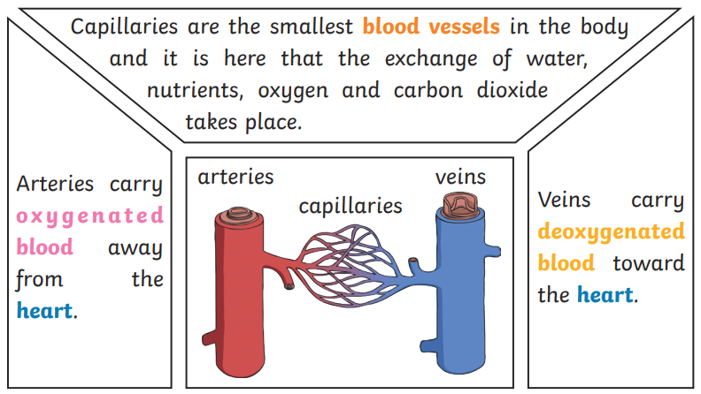
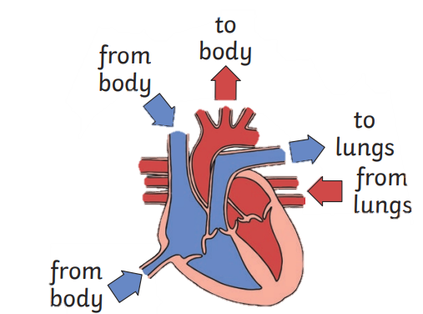
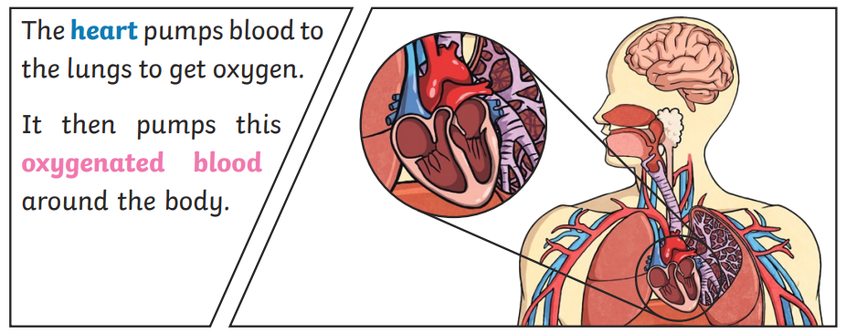
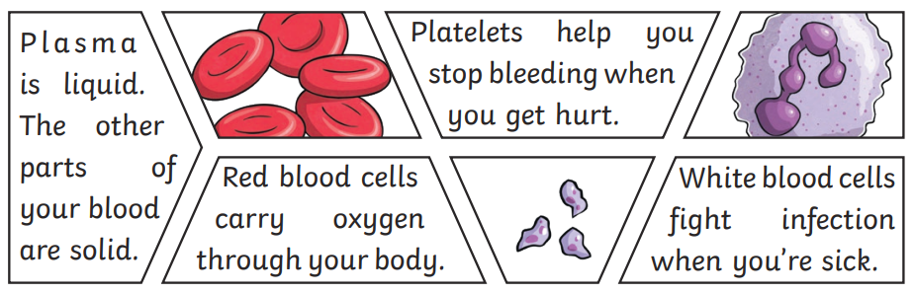
Year 6 | Science | Animals Including Humans
Key Vocabulary
1 | Circulat-ory system | A system which includes the heart, veins, arteries and blood transporting substances around the body.
2 | Heart | An organ which constantly pumps blood around the circulatory system
3 | Blood vessels | The tube-like structures that carry blood through the tissues and organs. Veins, arteries and capillaries are three types of blood vessels.
4 | Oxygena-ted blood | Oxygenated blood has more oxygen. It is pumped from the heart to the rest of the body.
5 | Deoxyg-enated blood | Deoxygenated blood is where most of the blood has already been transferred to the rest of the body.
6 | Drug | A substance containing natural or manmade chemicals that has an effect on your body when it enters your system.
7 | Alcohol | A drug produced from grains, fruits or vegetables when they are put through a process called fermentation.
8 | Nutrients | Substances that animals needs to stay alive and healthy.
Key Knowledge
1 | Mammals have hearts with four chambers. The blood that has come from the body is deoxygenated, and the blood that has come from the lungs is oxygenated again.
2 | The liquid part of the blood contains water protein. This is called plasma.
3 | Blood transports: - Gases (mostly oxygen and carbon dioxide) - Nutrients (including water) - waste products.
4 | Drugs, alcohol and smoking have negative effects on the body.
5 | A healthy diet involves eating the right types of nutrients in the right amounts.
6 | If you linked up all of the bodies vessels, including arteries, capillaries and veins, they would measure over 60,000 miles.
Useful Diagrams
1
2
3
FUN FACT!
If the red blood cells from one person were to be stacked in the sky, they would reach 31,000 miles!

